Slide 1
Terrain Generation
With the help of AI
By - Ed Warneken, Harry Fletcher and Ewan Walker
Project Leader – Nick Keepfer

Slide 2
What do we mean by terrain generation?
Ed Warneken
The creation of a realistic map of a terrain using specific algorithms layered on top of each other.
Why is it used ?
Video games
Map creating and editing applications
For example

Slide 3

Terraria
Ed Warneken

Slide 4

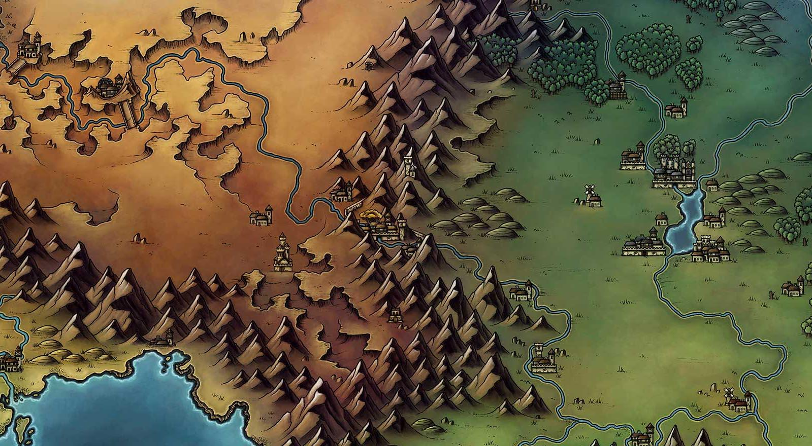
WorldAnvil
Create and edit your own world
Algorithms are used to generate the shape and size of continents as well as different features in the landscape.

Slide 5

Minecraft
Uses multiple terrain generation methods.
Specific algorithms are used to generate certain types of biomes.
Deserts, plains and forests.
Underground caves and ravines.
Height of the terrain:
Larger h value = jagged surface.
Smaller h value = smoother surface

Slide 6
What are our objectives? Harry Fletcher
Realistic generation from few data points – What we want
How?
Researched different methods for generating terrain
Coding the different methods
Condense using Principal Component Analysis
Finding optimal principal values for efficiency
Identify features across different pre-existing generations

Slide 7
Researching methods for Terrain Generation Harry Fletcher
Midpoint Displacement
Cellular Automata
Diamond-Square
Perlin noise
Building knowledge to use in progressively higher dimensions
Comparing looks of generations

Slide 8
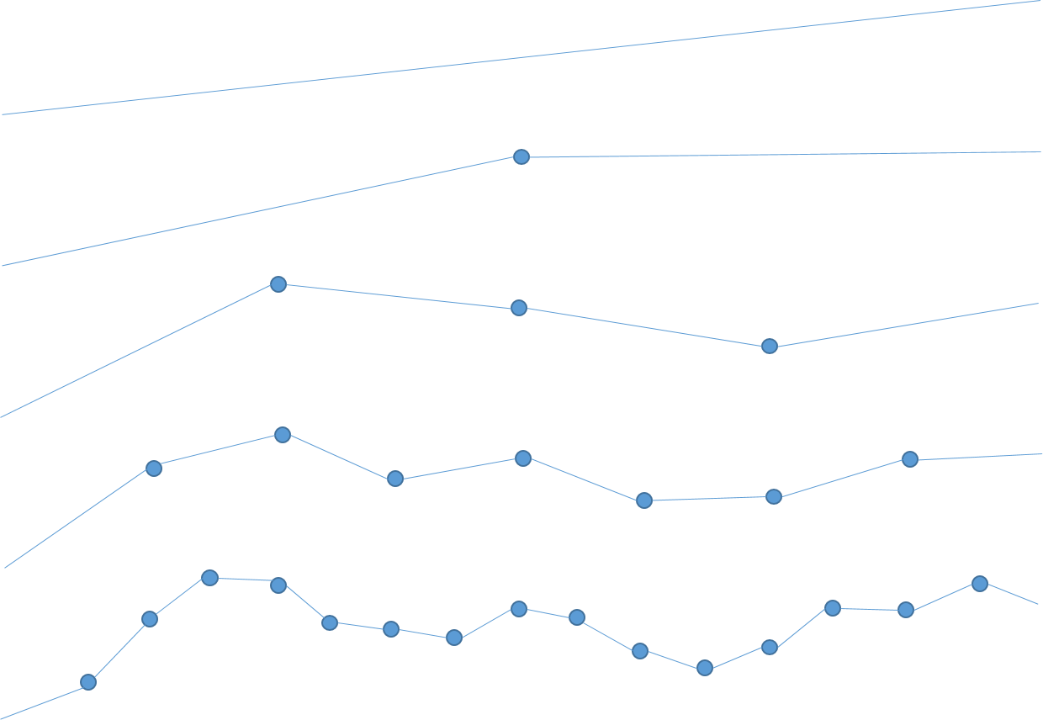
Midpoint Displacement – Theory
Ewan Walker
References:
Info, graphic -https://dl.acm.org/doi/pdf/10.1145/325165.325247
Purpose:
Primarily 1D generation to create a 2D landscape but also for graphical applications (i.e., rivers/ravines/paths):
Procedure:
Select 2 x values for the end points
Calculate the midpoint
Randomly displace the midpoint y coordinate between a set range of values scaled by a h (height) parameter.
Iteratively repeat steps (1-3) between every connected point a set number of times, decreasing the h scale each time to smooth the line out.
Remove as much noise as possible
Variables:
– The range of possible displacement values – Initial h – Consecutive – the scaling factor of h down iteratively

Slide 9
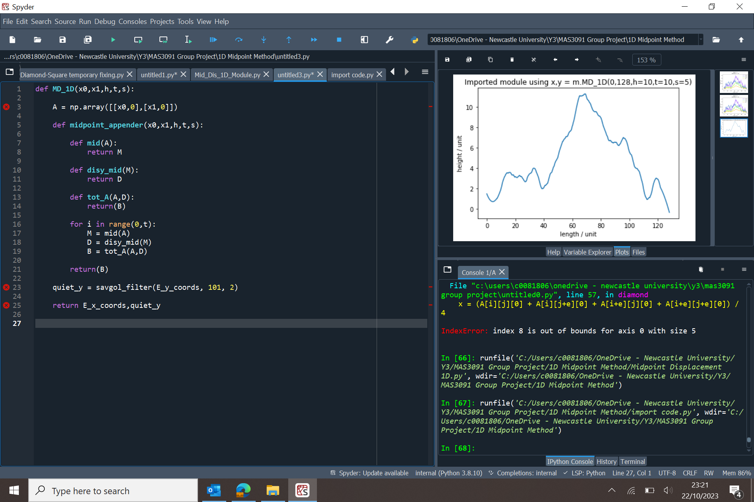
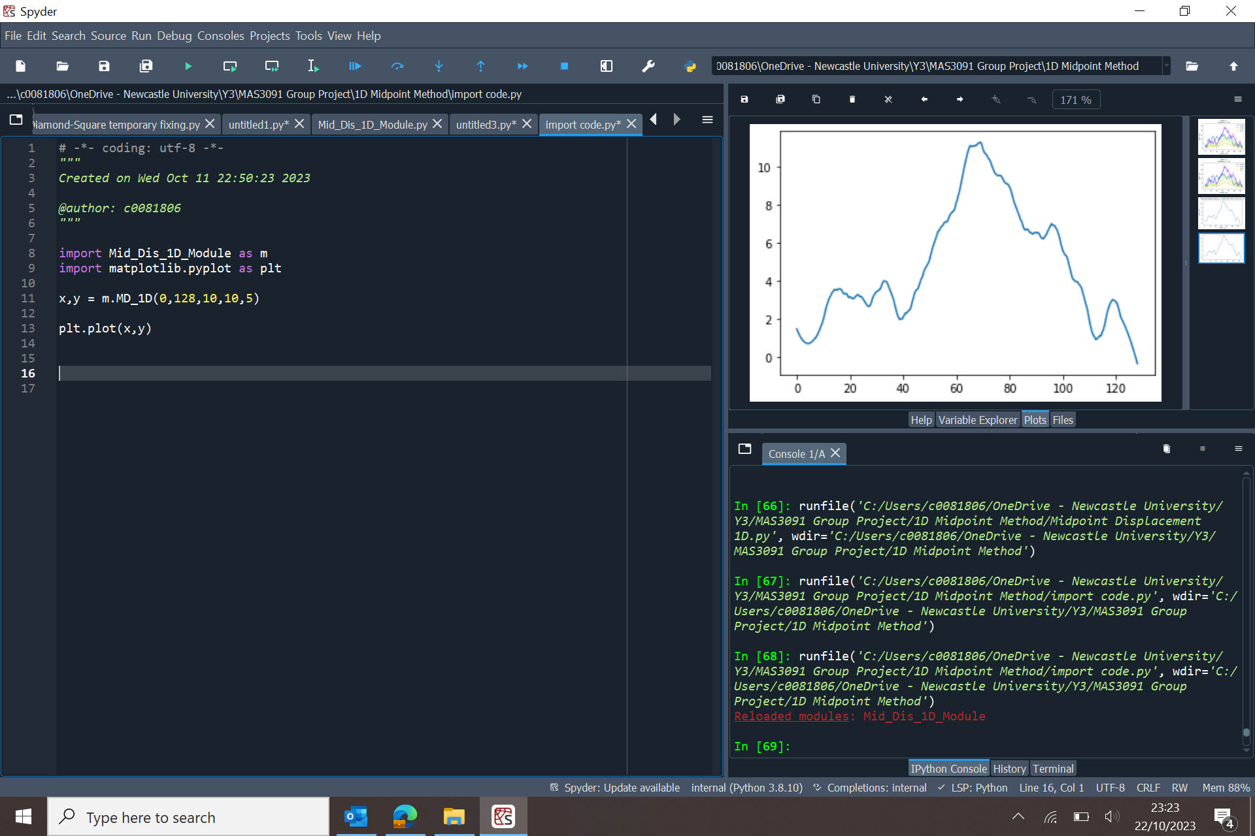
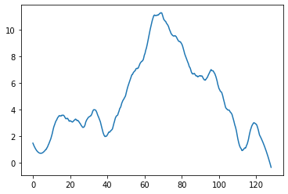
Midpoint Displacement – Python (pseudo)
Ewan Walker
Module
Import
Result

Slide 10
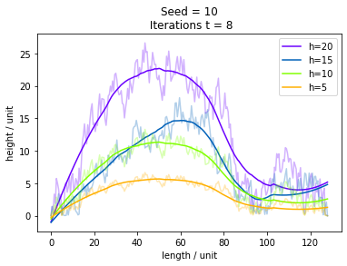
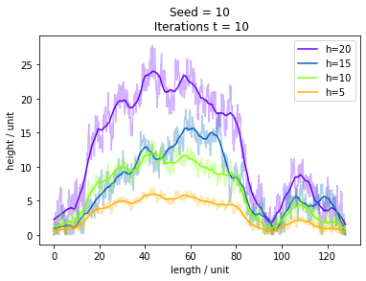
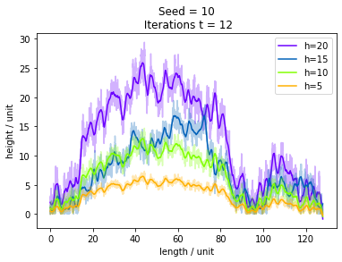
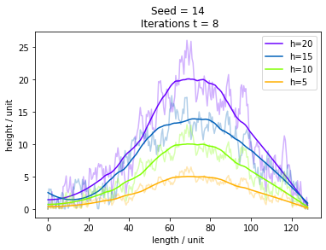
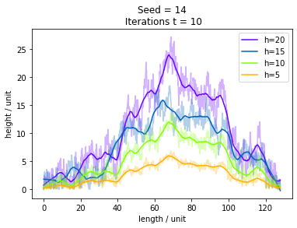
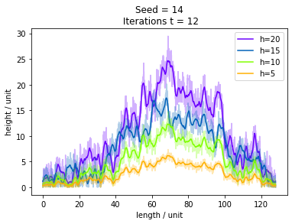
Midpoint Displacement – Result Analysis
Ewan Walker
Plots - Top 3 & bottom 3
Each their own seed
Plots - left to right:
More iterations
-------------------------------------
Individual plots:
Vary h parameter
Noisy transparent is the displacement code
Smooth solid line is post Savitzky-Golay Filter (MSE line)

Slide 11
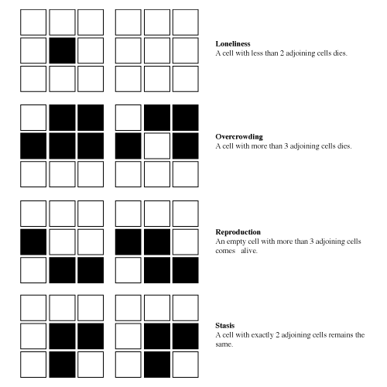
Cellular Automata
Generates a cave-like terrain.
Cells have a finite number of states.
Surrounding cells determine the state of the given cell.
Conway's Game of Life:

Slide 12
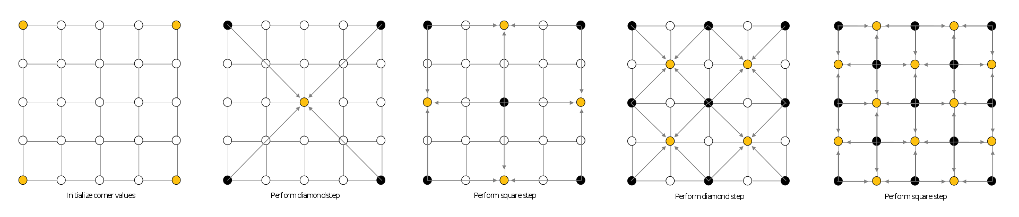
Diamond-Square – Theory
Ewan Walker
References:
Info, graphic - https://en.wikipedia.org/wiki/Diamond-square_algorithm
Purpose: Create a matrix of heightmap values to generate 3D terrain.
Procedure:
From a 2D square (size 2n + 1) array set the 4 corners with initial values.
Diamond step - for the midpoint of each square of coordinates, average the 4 corner values with some additional random value. If an edge, use a 4th value from the other side of the array (wrap).
Square step - for each diamond, set its value to be average of its 4 corners plus some additional random value. If an edge, use a 4th value from the other side of the array (wrap).
Repeat steps (2-4) but multiplying the random value by (2^-h , 0<h<1)
Variables:
• Array size n - size of the map
• Initial random range
• h - roughness of the terrain (low being rougher)

Slide 13
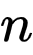
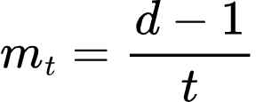
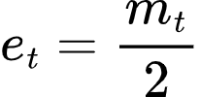
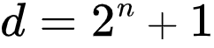
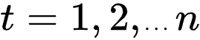
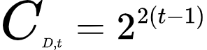
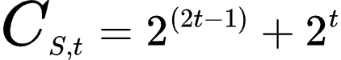
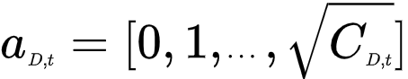
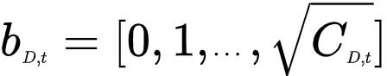
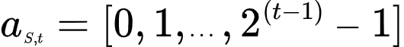
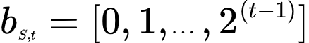
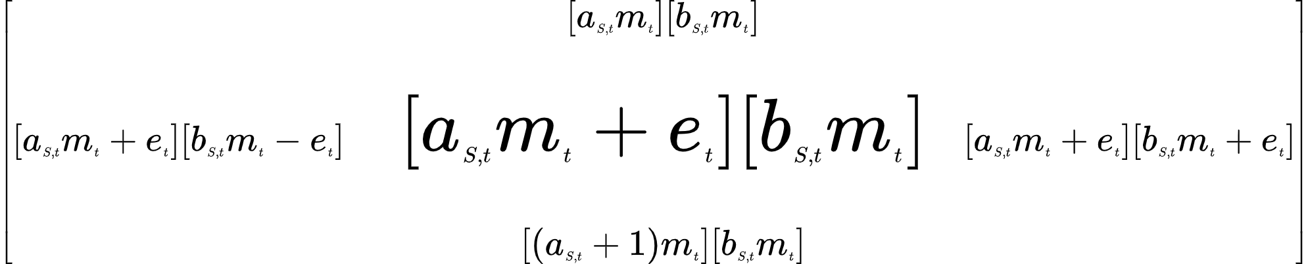
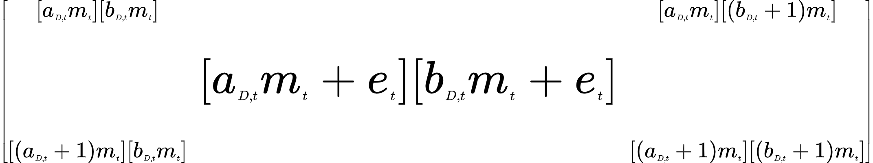
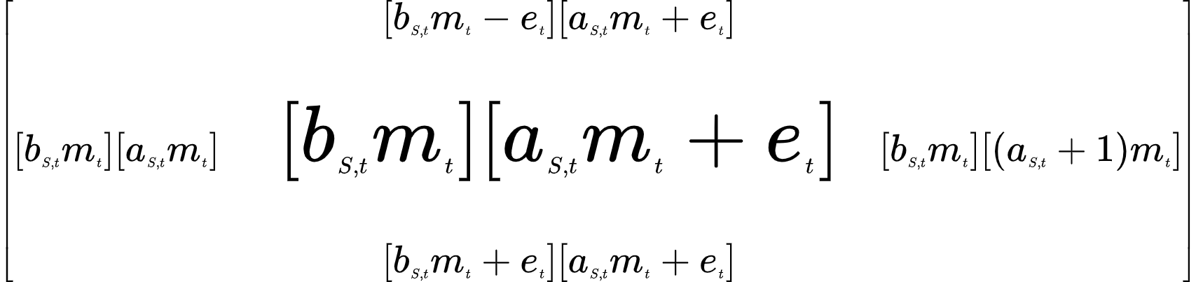
Diamond-Square – Maths
Ewan Walker
Step
Diamond
Square
Total target
cells
Sub-matrix
range
Target matrix
a rows, b cols
a rows, b cols
a cols, b rows

Slide 14
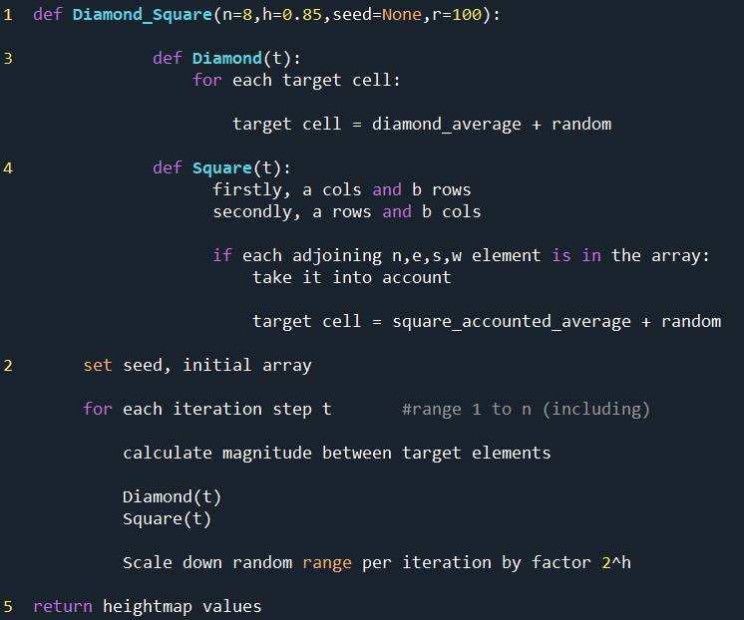
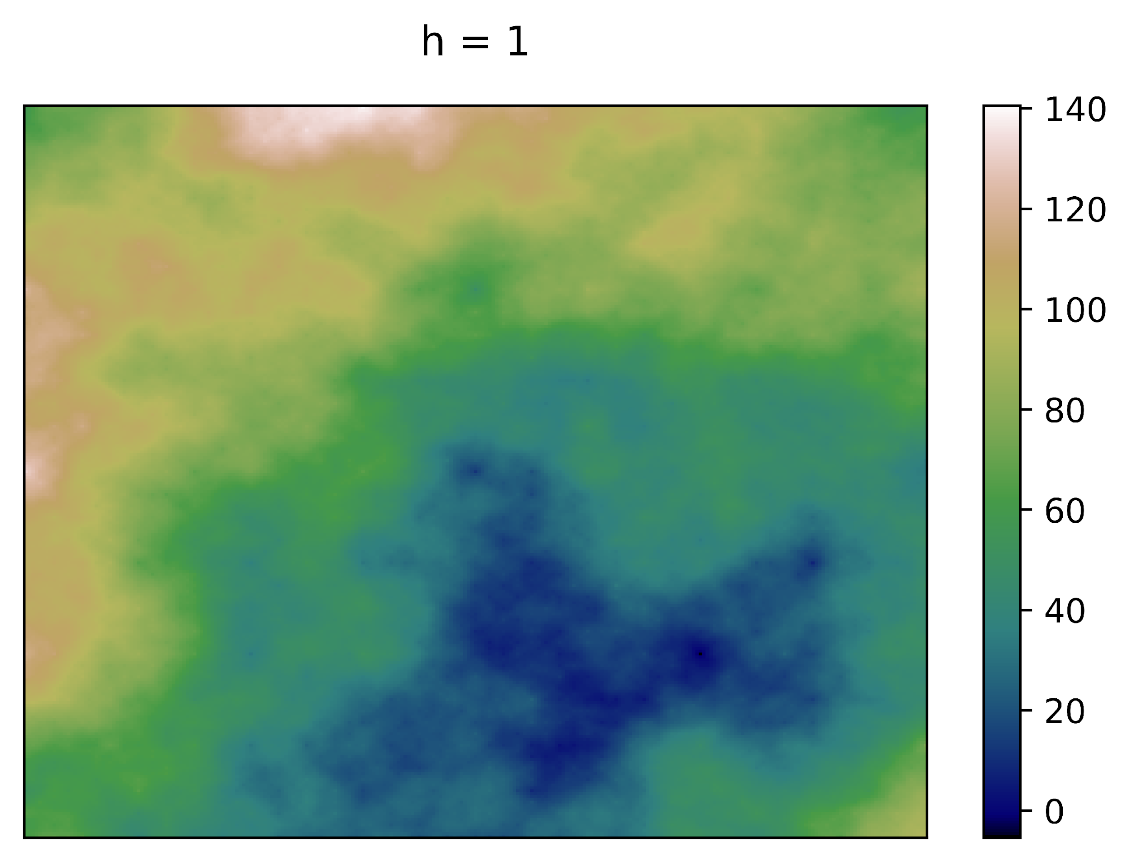
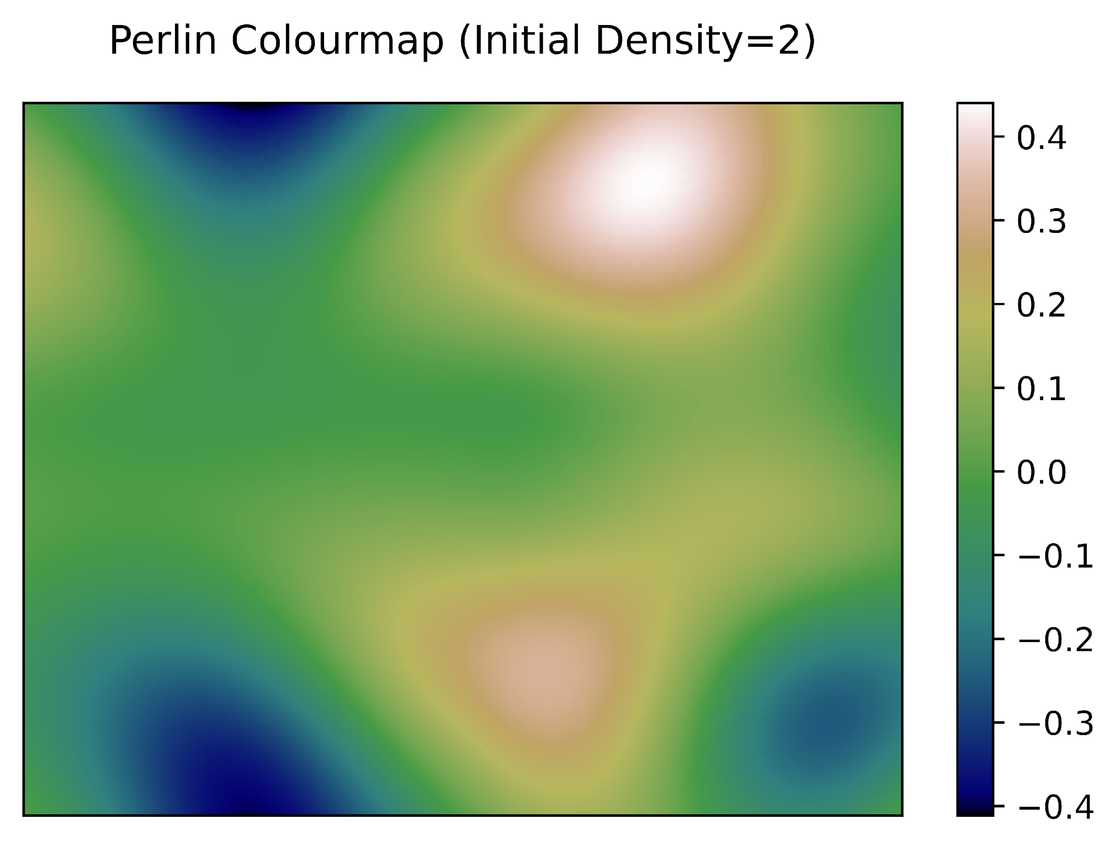
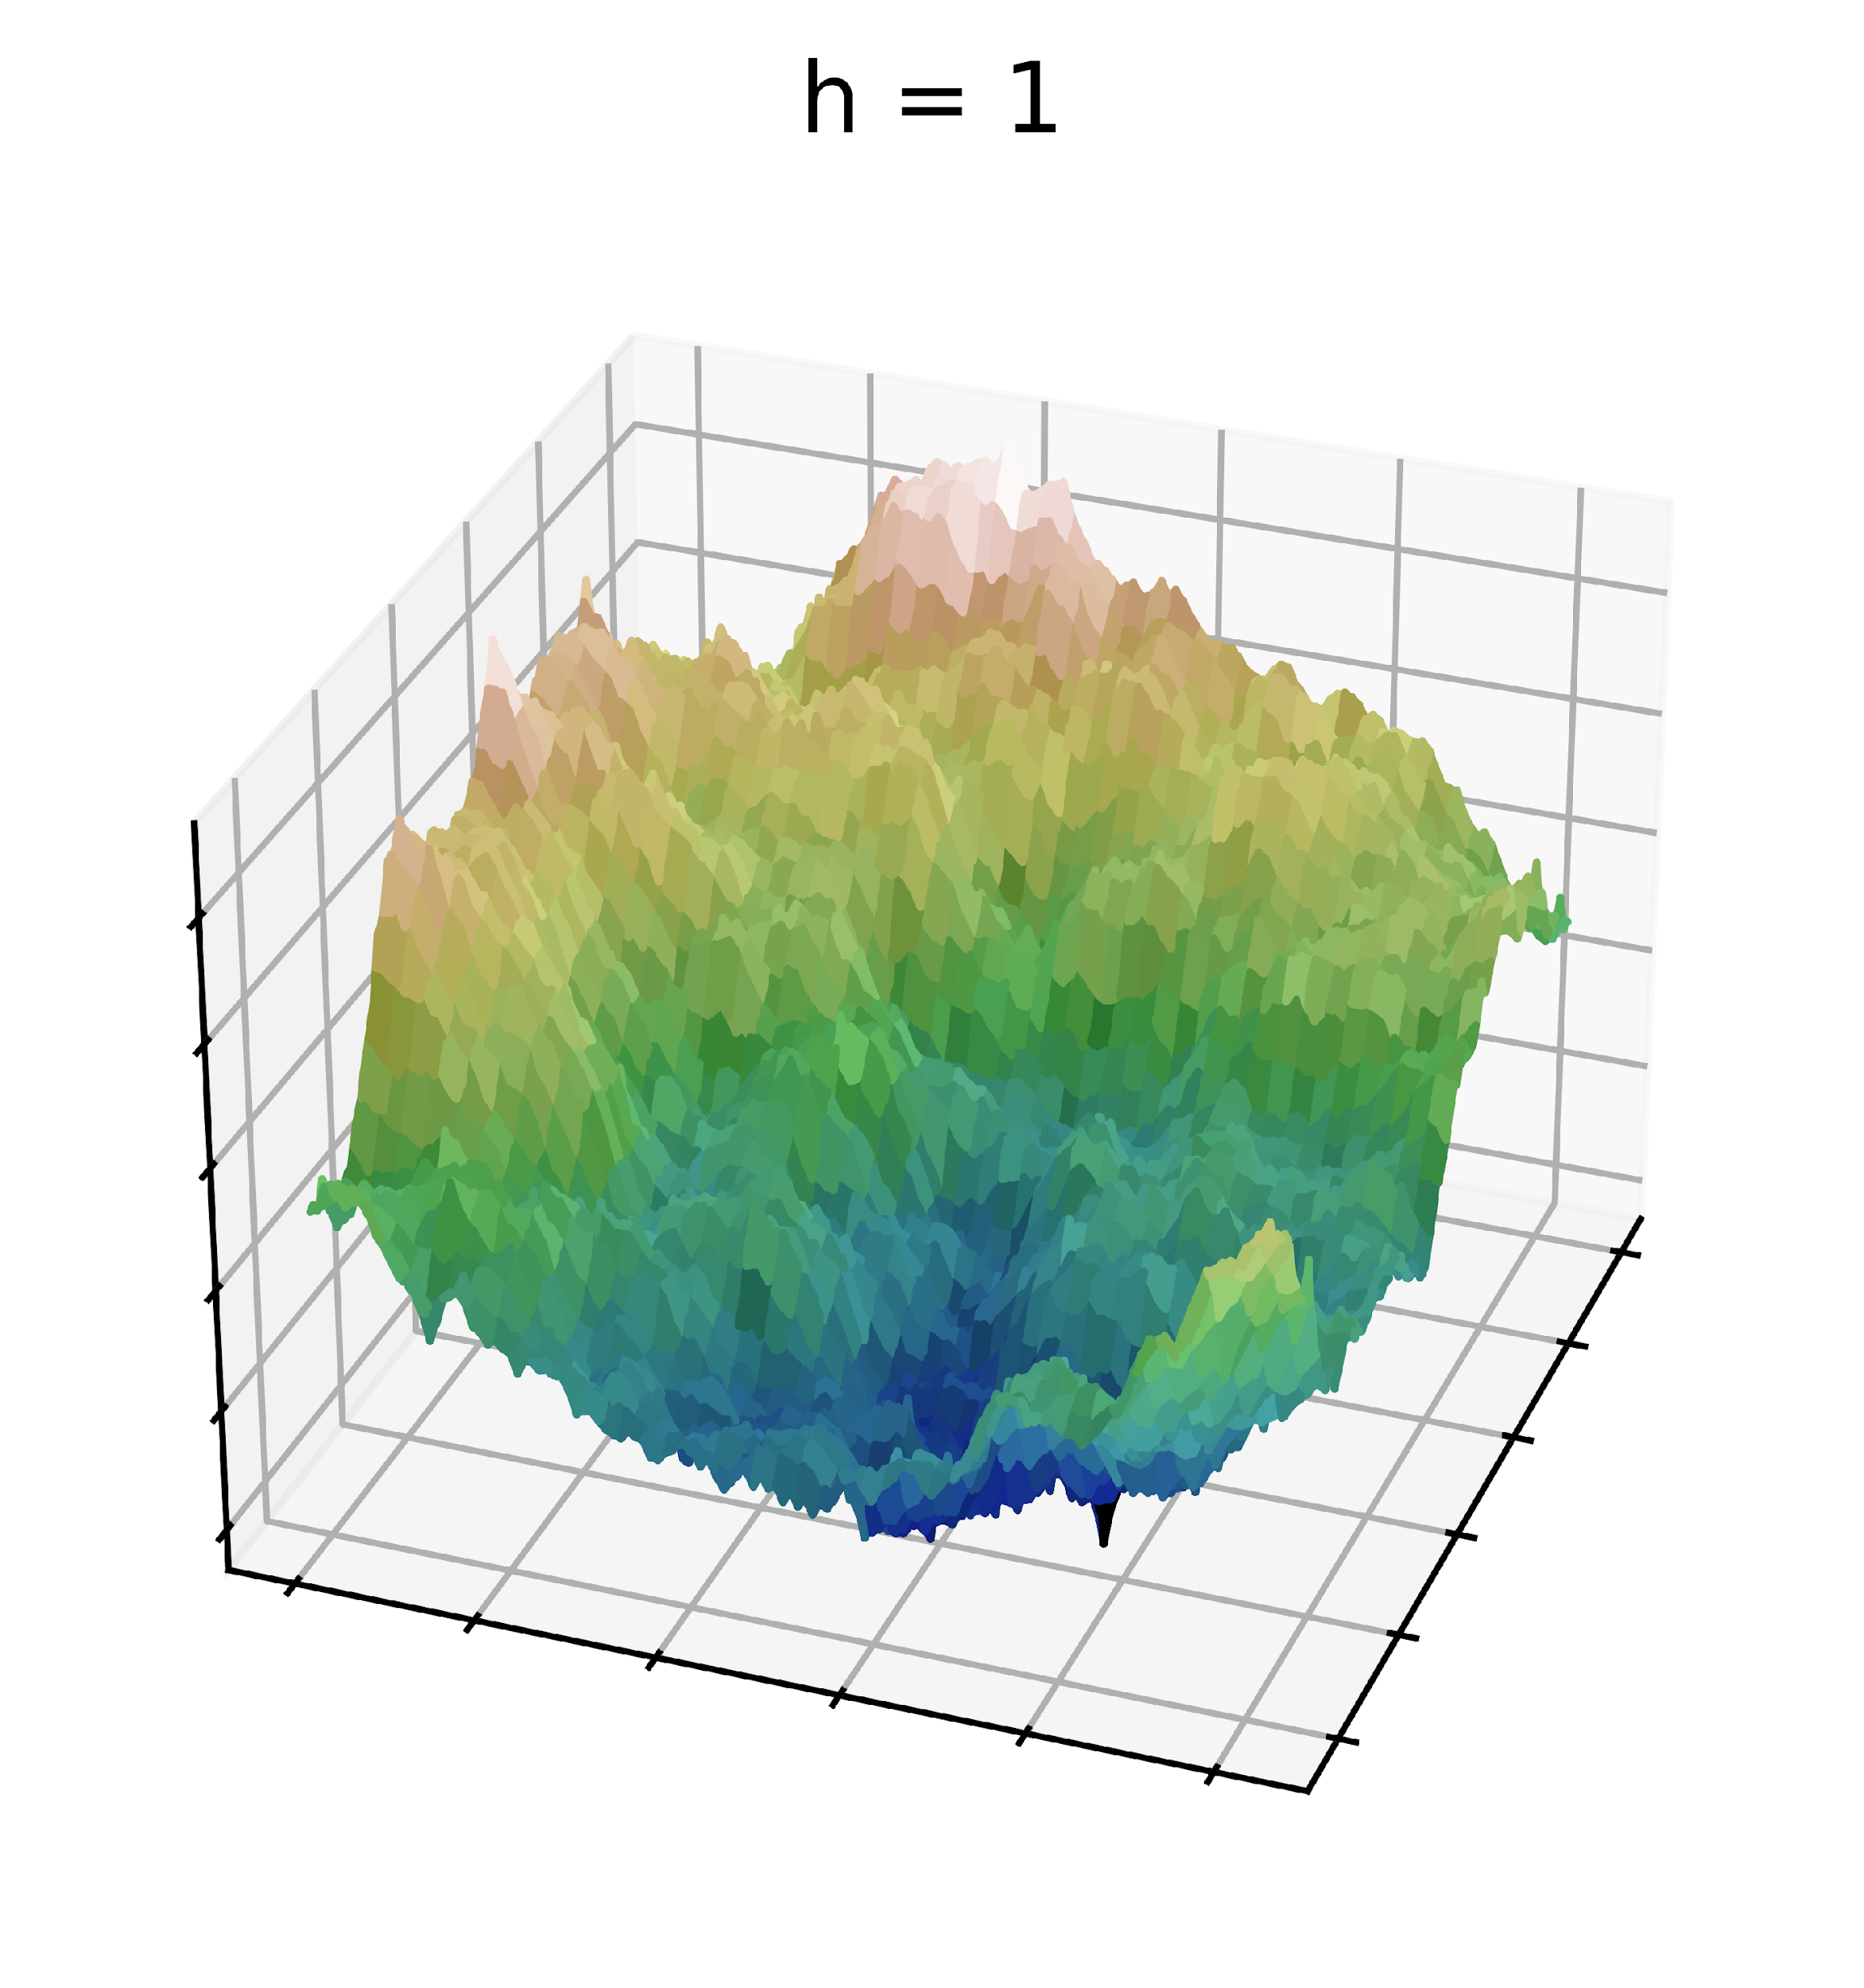
Diamond-Square – Python (pseudo)
Ewan Walker
1
0
-1

Slide 15
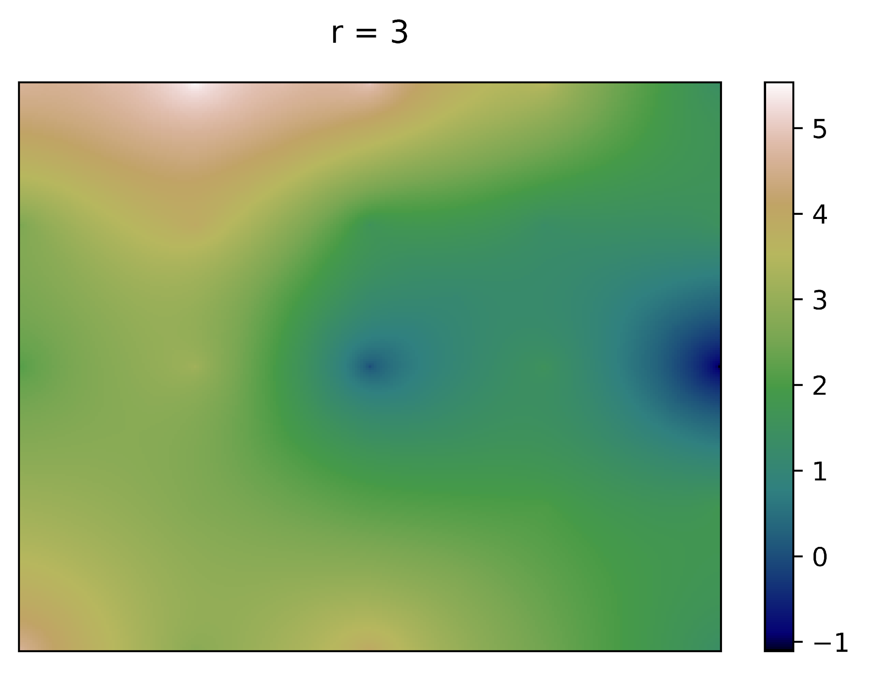
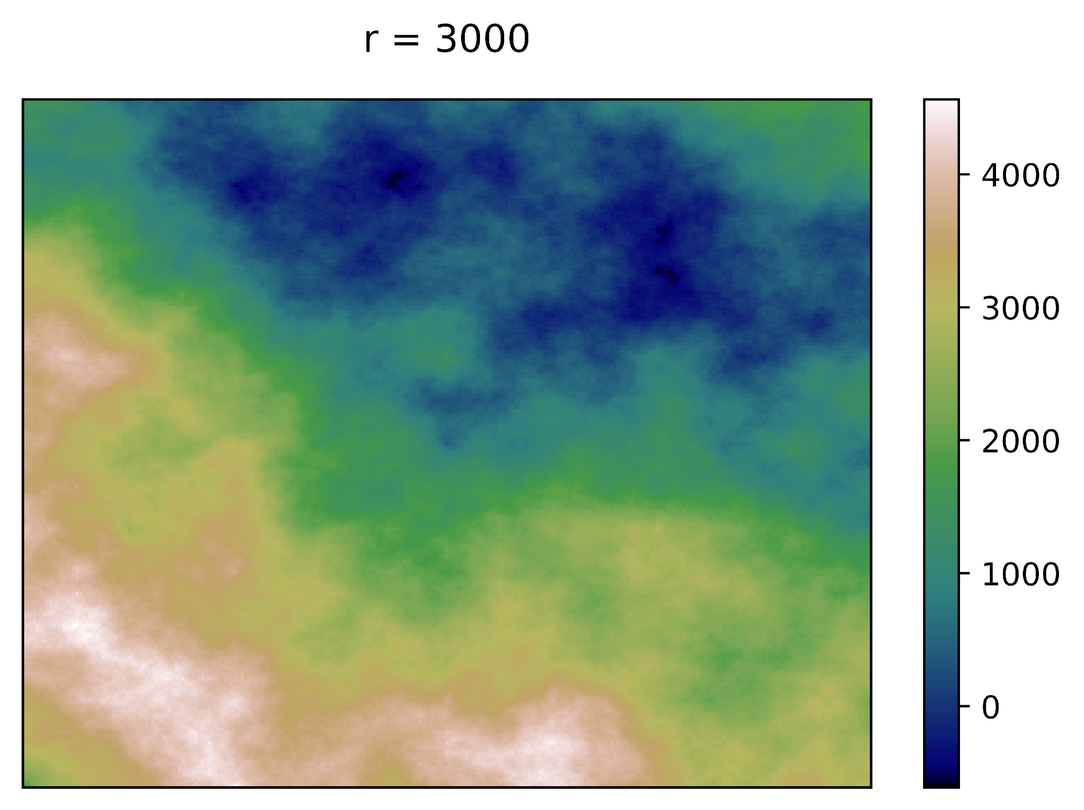
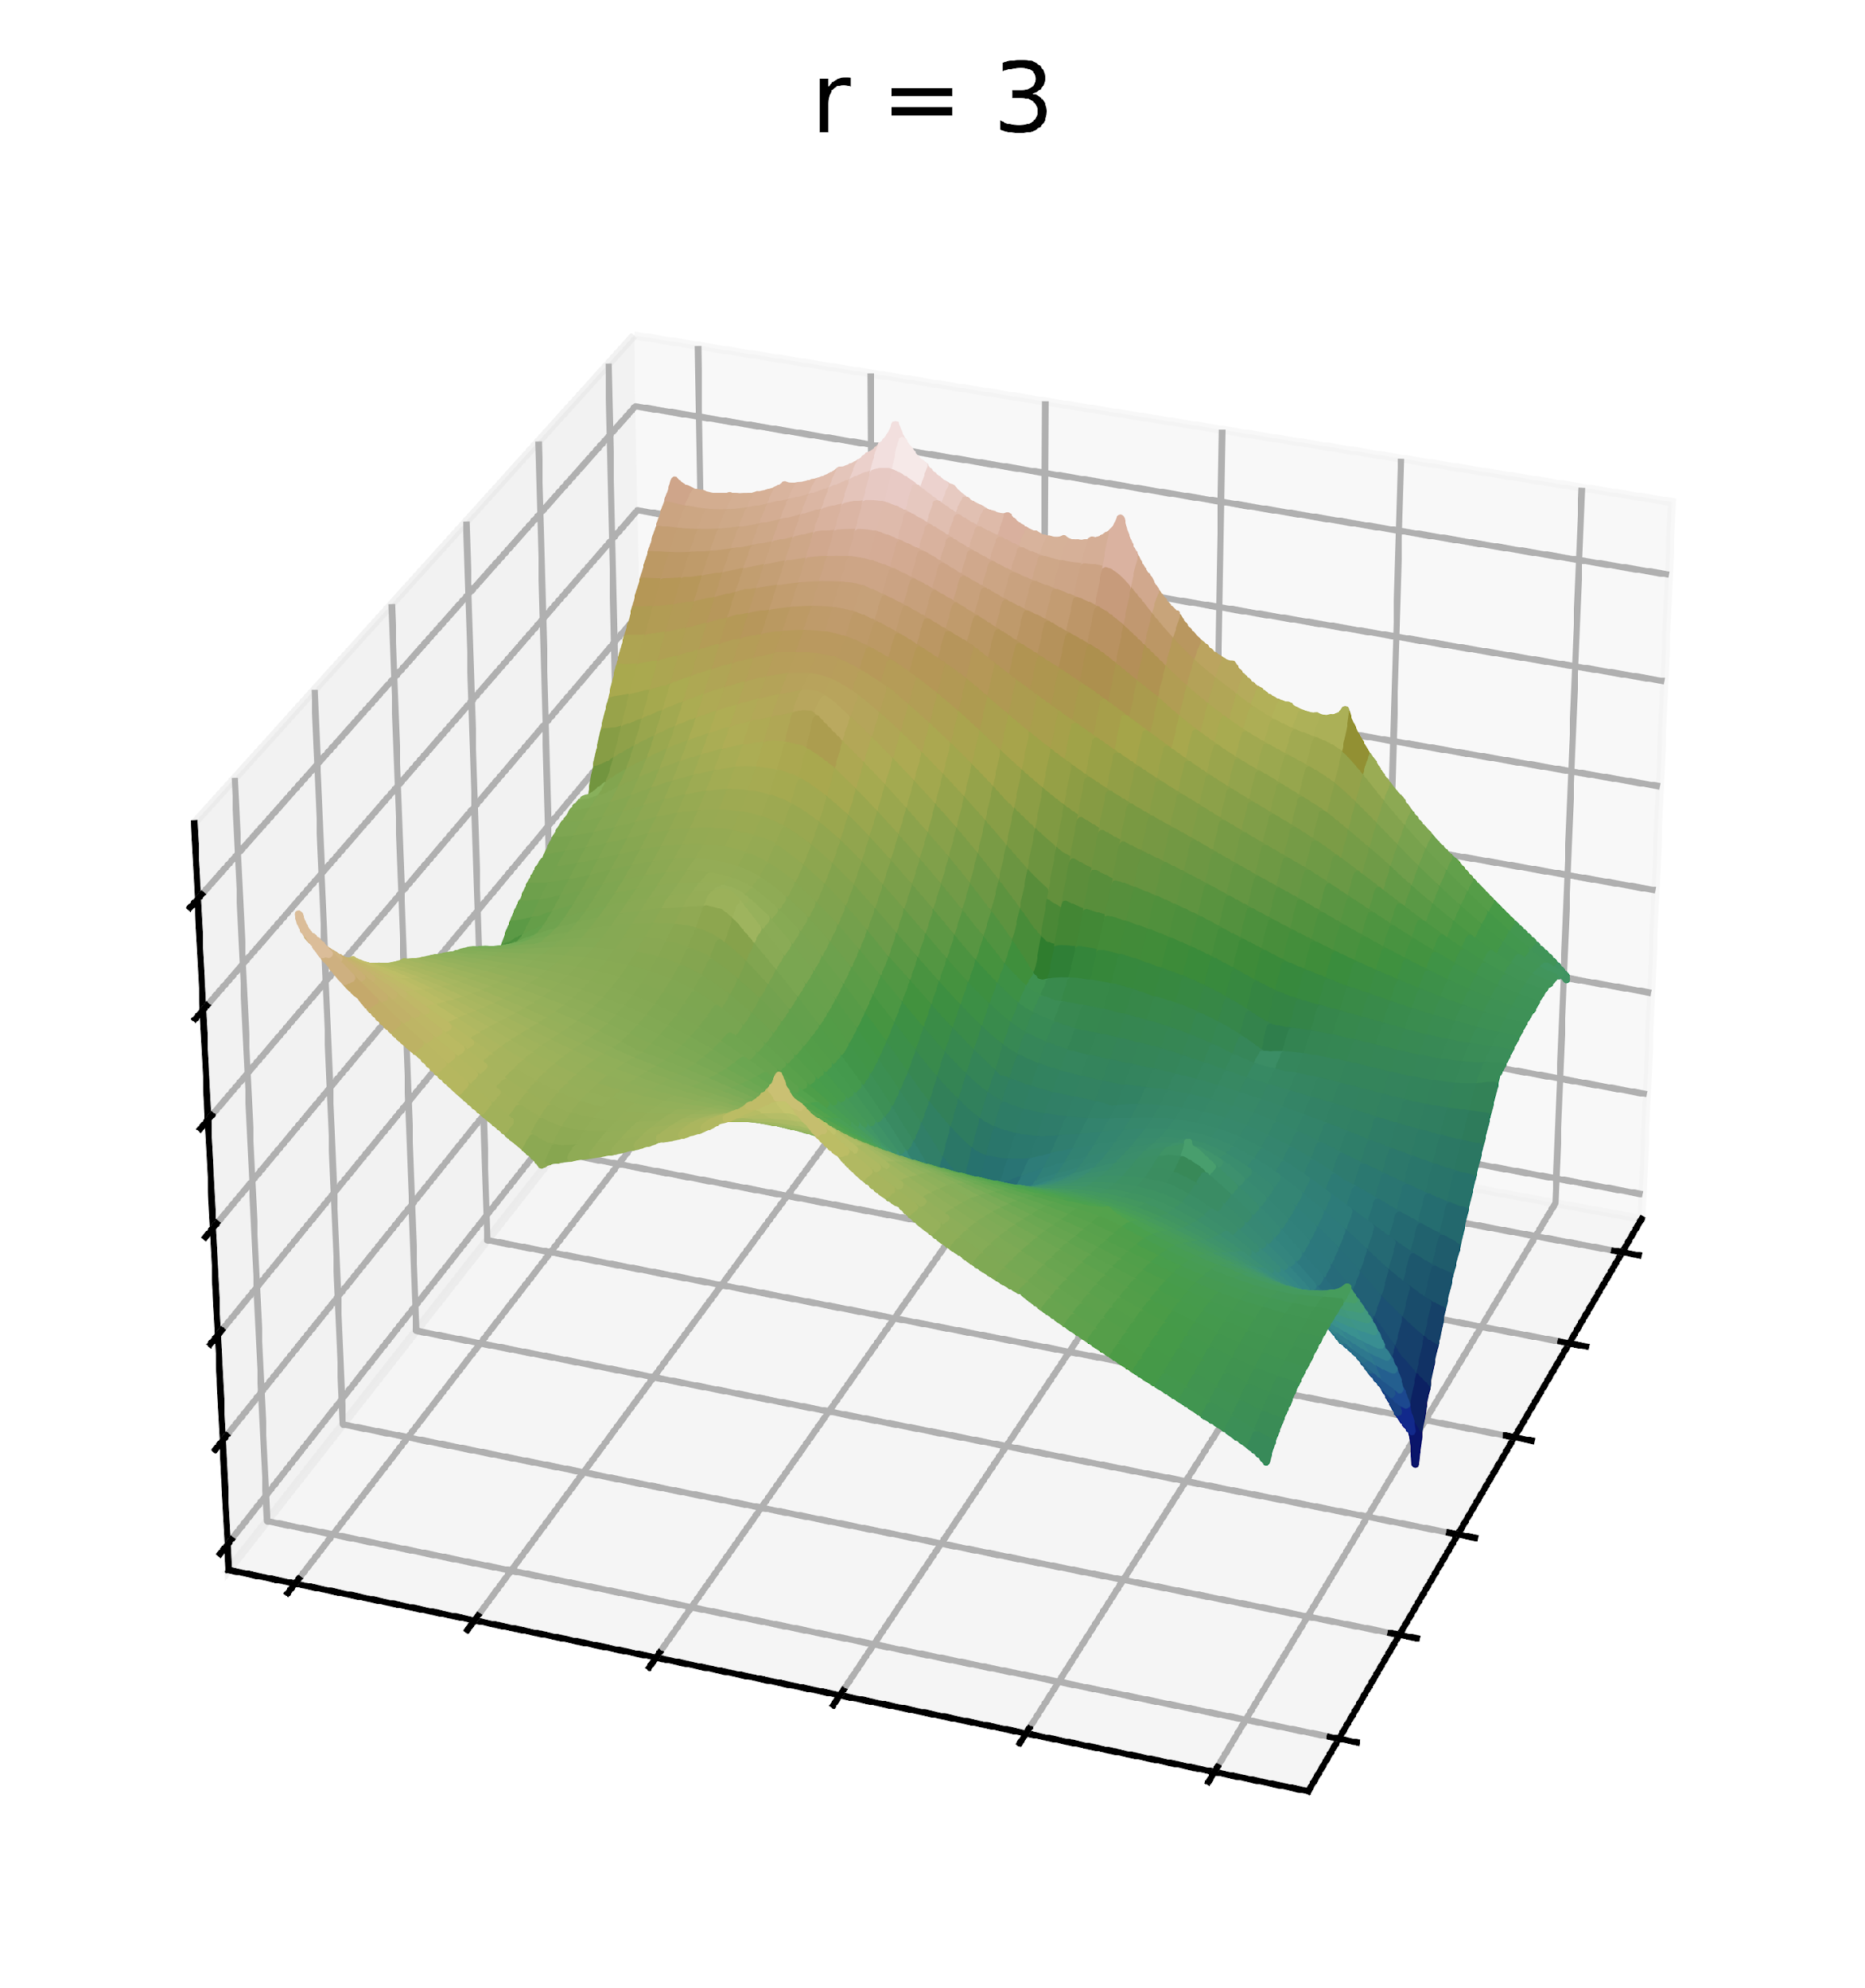
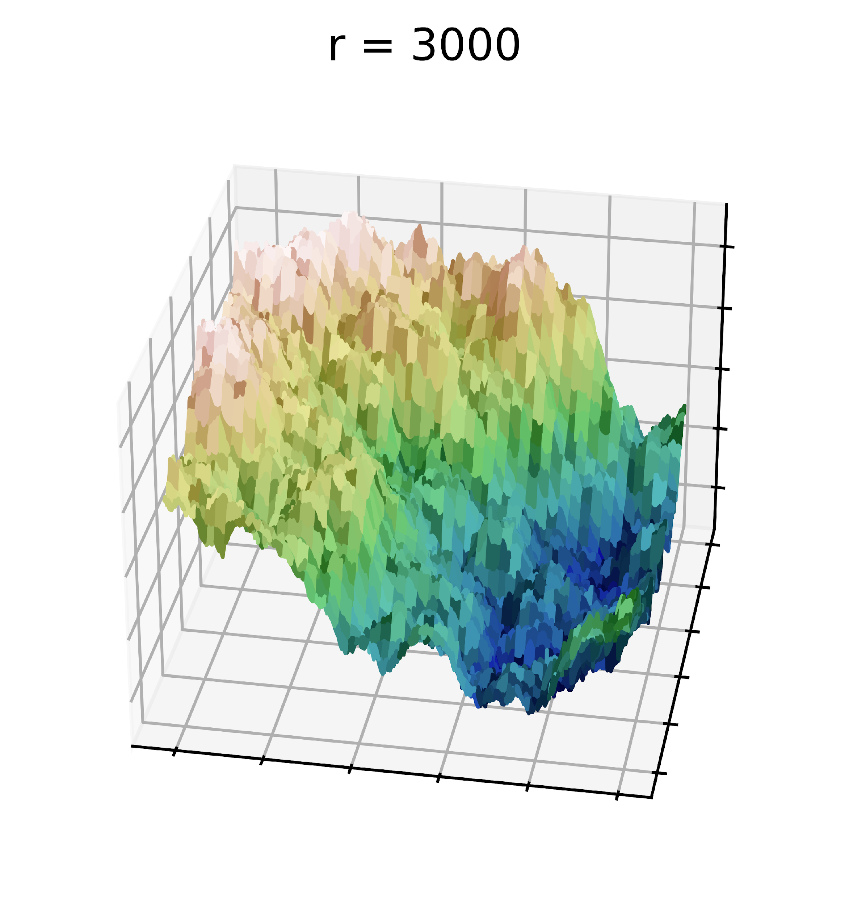
Diamond-Square – Result Analysis
Ewan Walker
1
0
-1

Slide 16
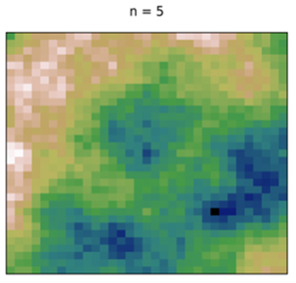
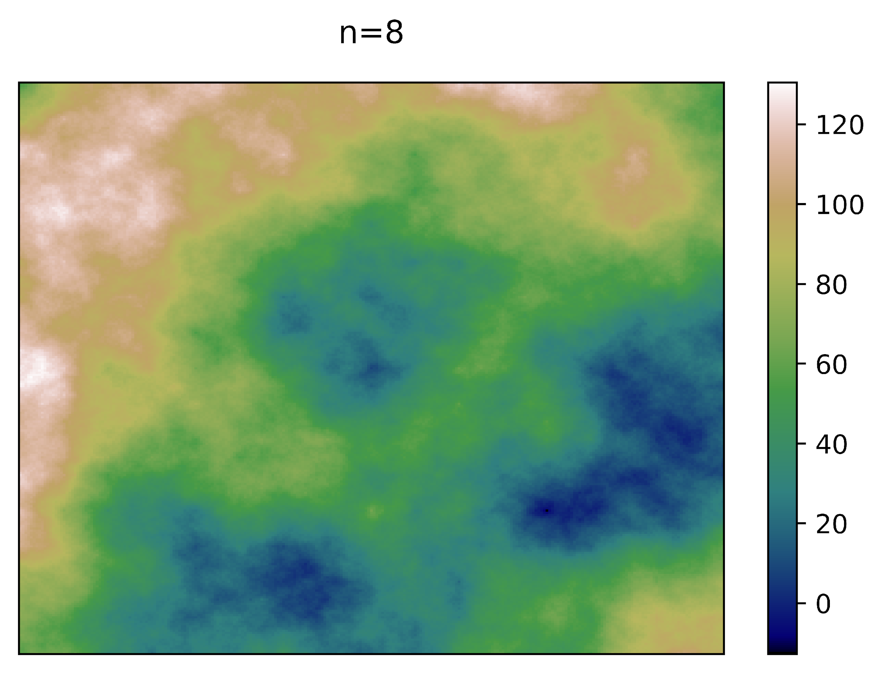
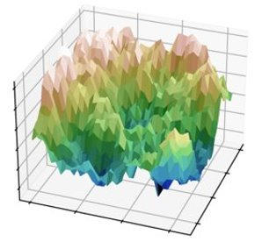
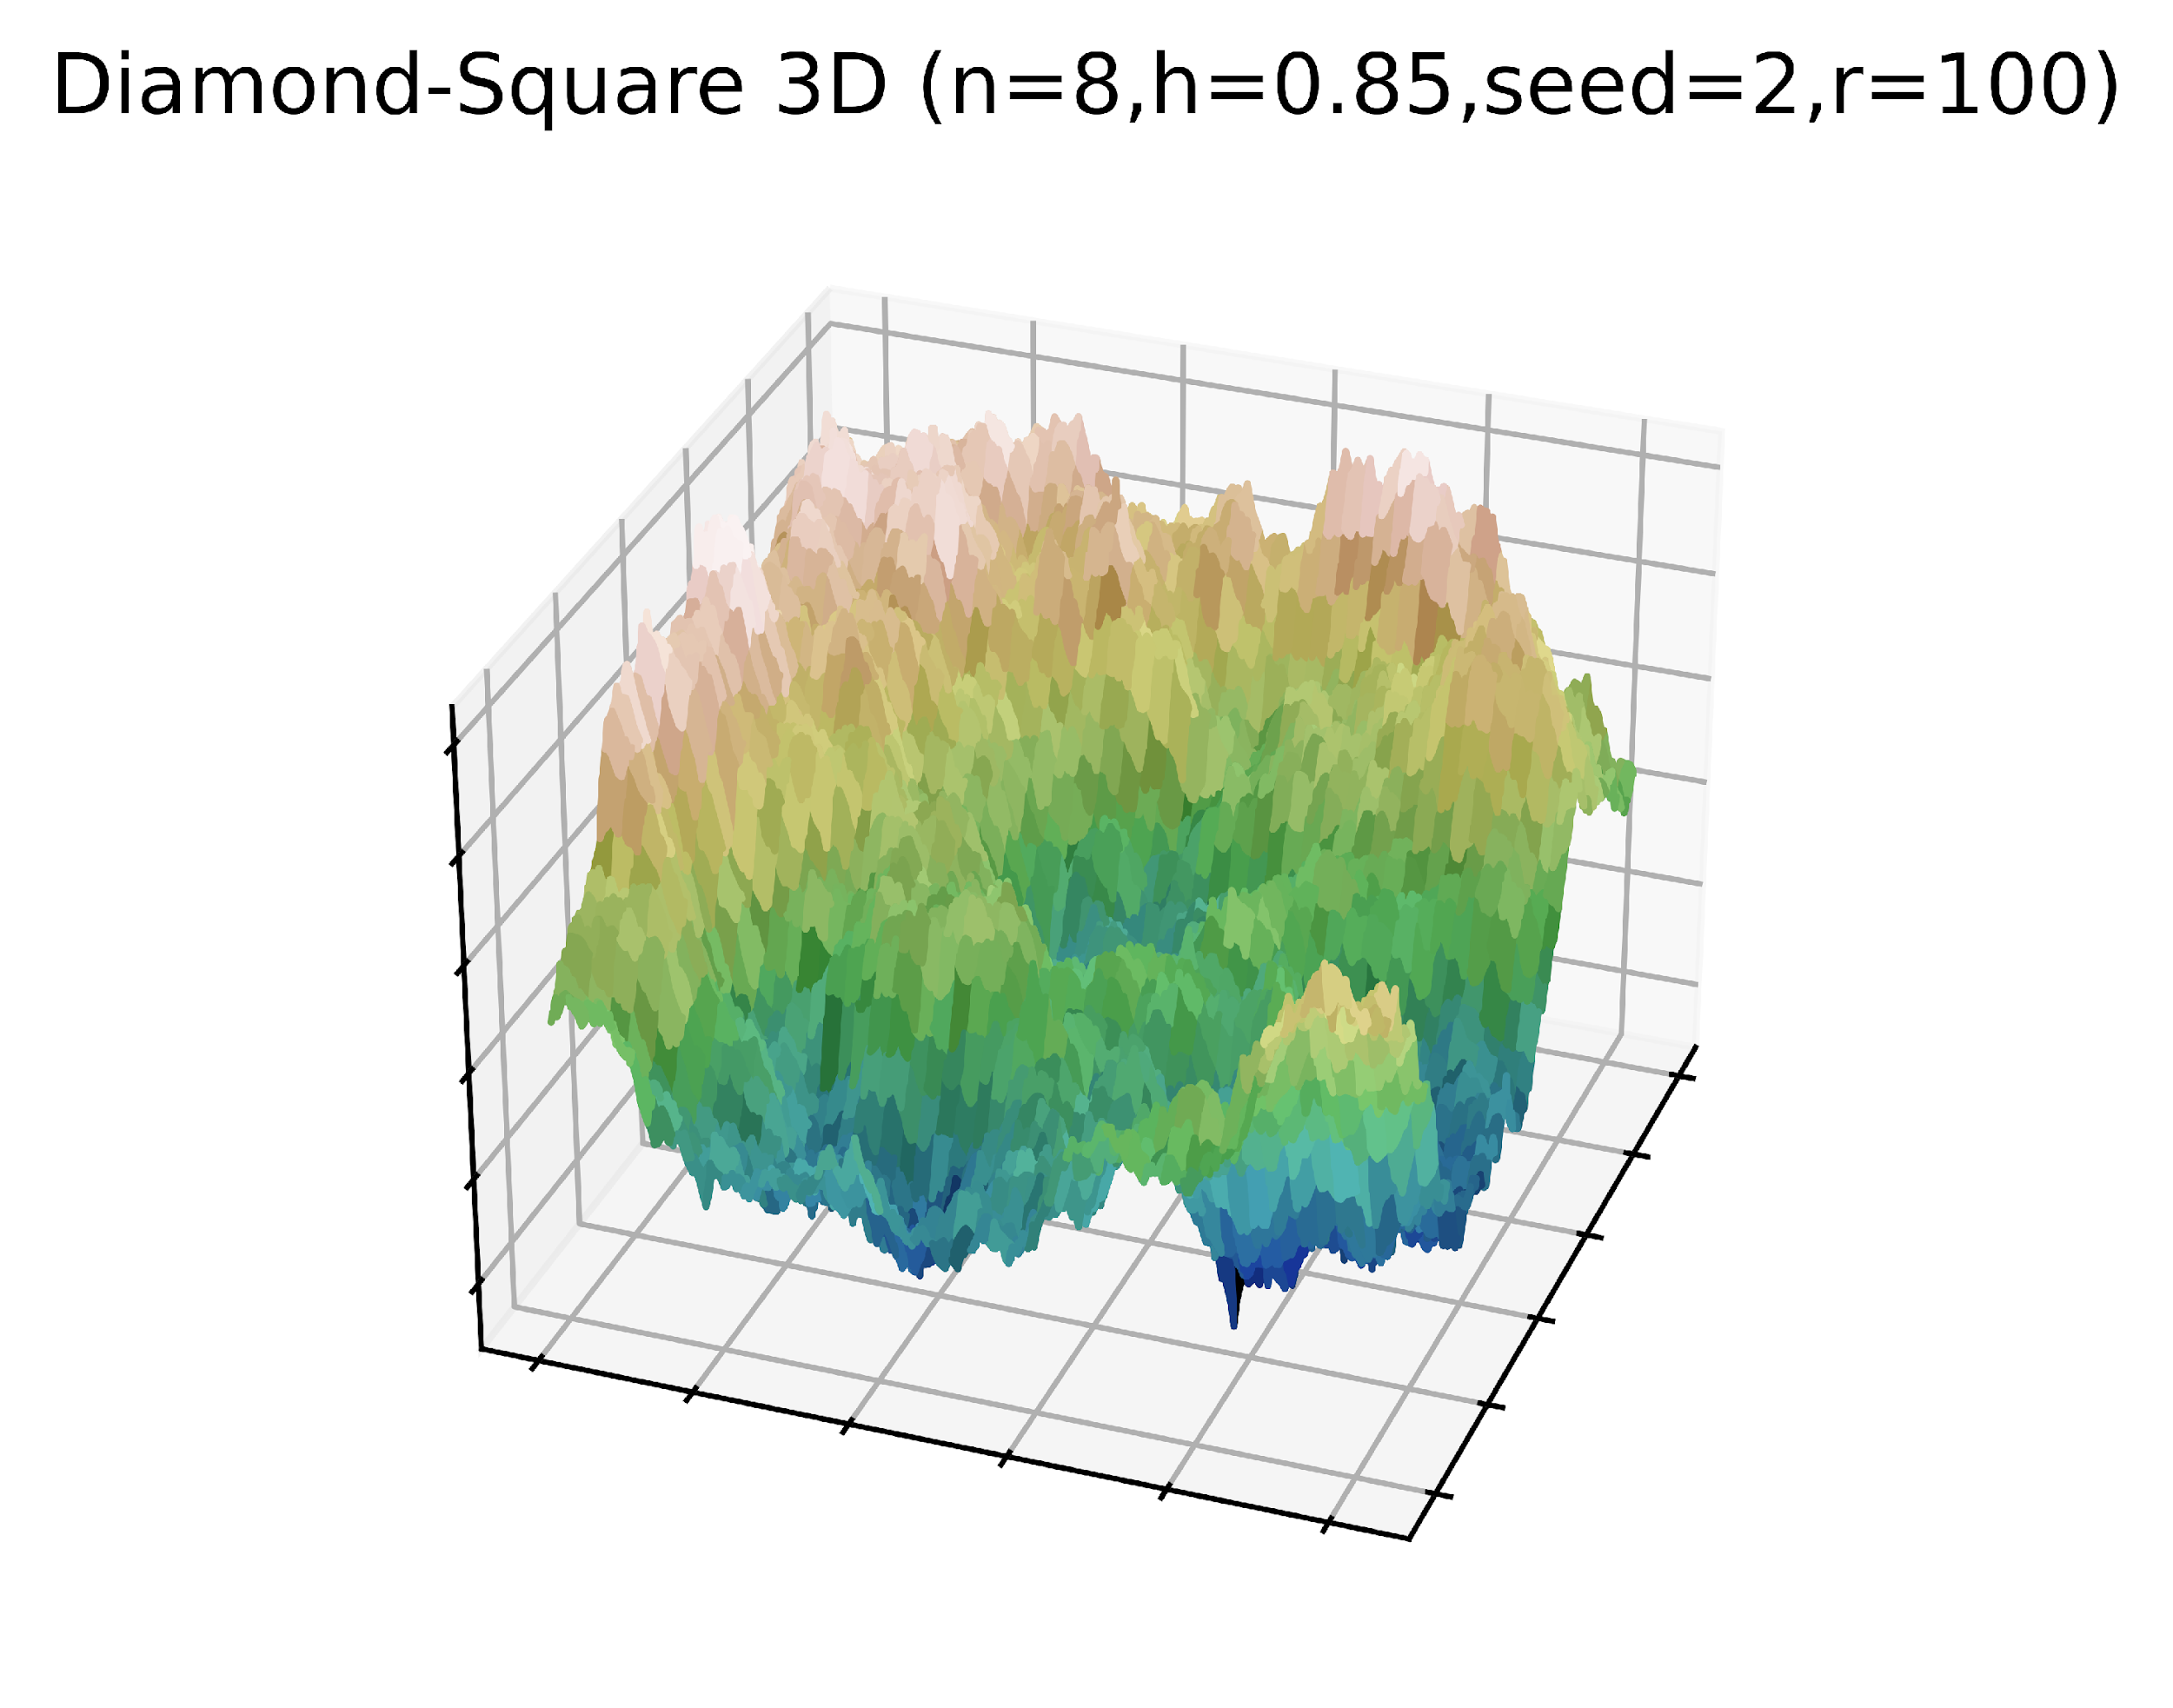
Diamond-Square – Result Analysis
Ewan Walker
1
0
-1

Slide 17
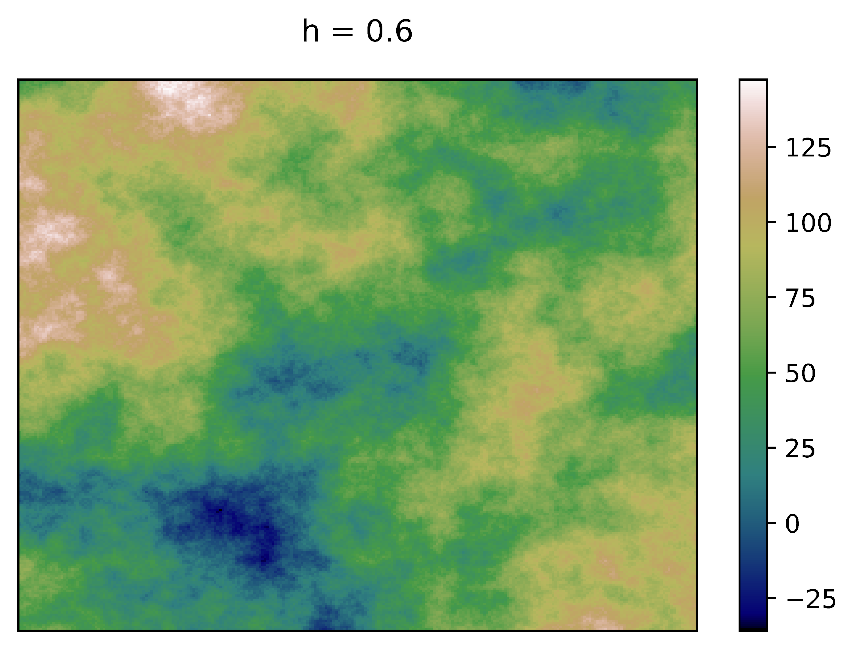
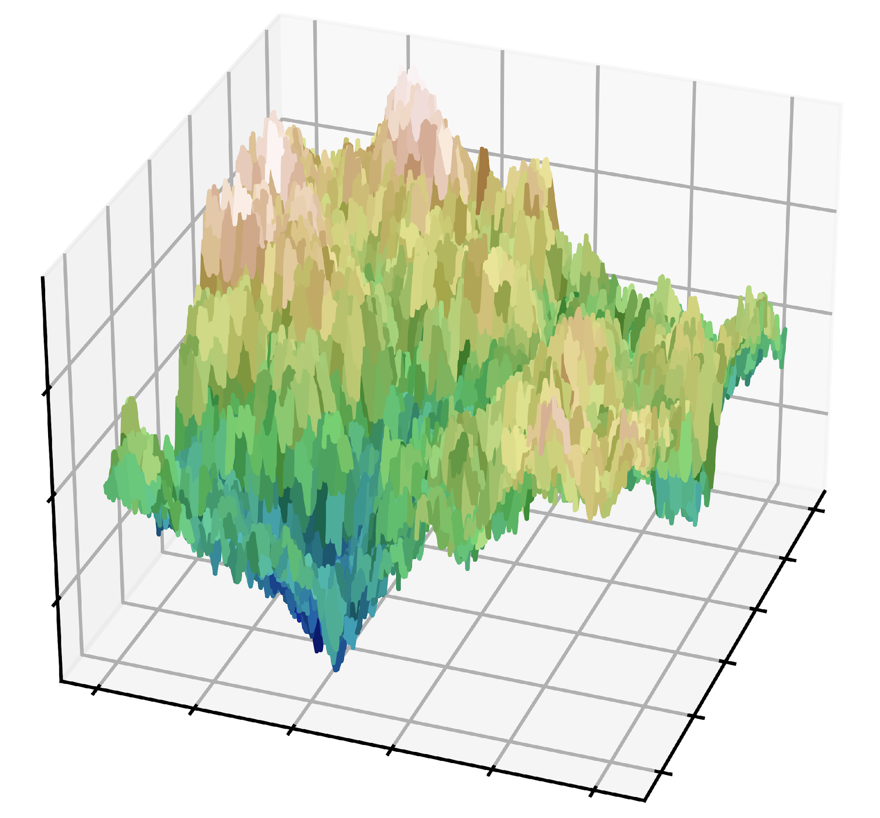
Diamond-Square – Result Analysis
Ewan Walker
1
0
-1

Slide 18
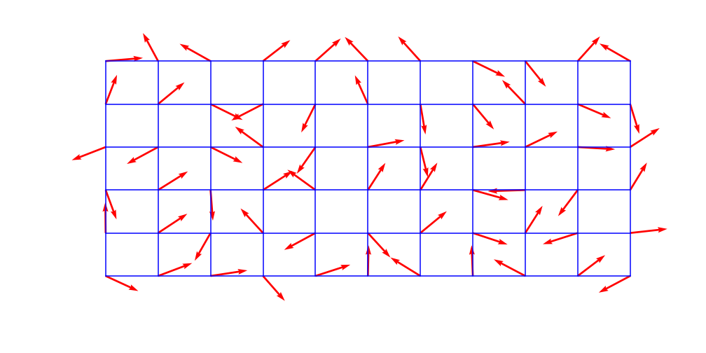
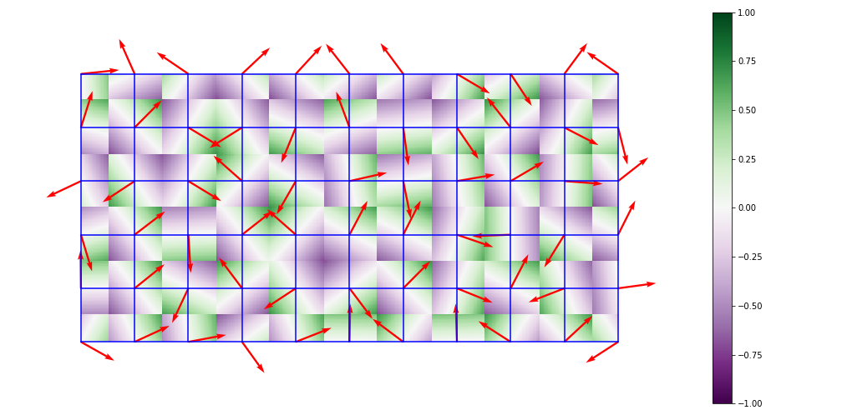
Perlin Noise – Theory 1/3
Ewan Walker
References:
Origin: Ken Perlin - An Image Synthesiser 19(3):287-296,1985- https://dl.acm.org/doi/pdf/10.1145/325165.325247
Info, graphics - https://en.wikipedia.org/wiki/Perlin_noise
A
B
Perlin Noise (developed by Ken Perlin [An Image Synthesiser – ACM SIGGRAOH Computer Graphics, 19(3):287-296, 1985]) can create a heightmap for any dimension. Here, we look at 2D to 3D.
Create a 2D grid of cells and assign each intersection with a unit vector of gradient between -1 and 1.
For every point in the whole grid, calculate the displacement vector (d) of said point with its nearest cell corner.
Calculate the dot product of all these d vectors and the corresponding corner vector. This is shown in image B (colour coordinated).

Slide 19
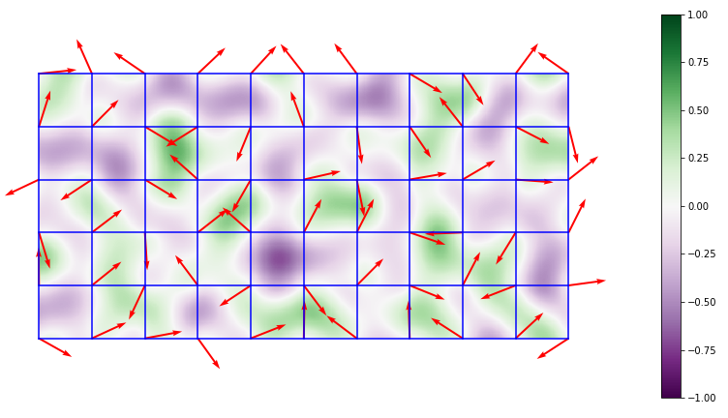
Perlin Noise – Theory 2/3
Ewan Walker
B
C
4. Repeat this process but to the other 3 corners of each cell to get 4 total sets of gradients.
5. Combine the 4 sets of the gradients (dot product values) together using a "smoothstep function" to get to the heightmap C.

Slide 20
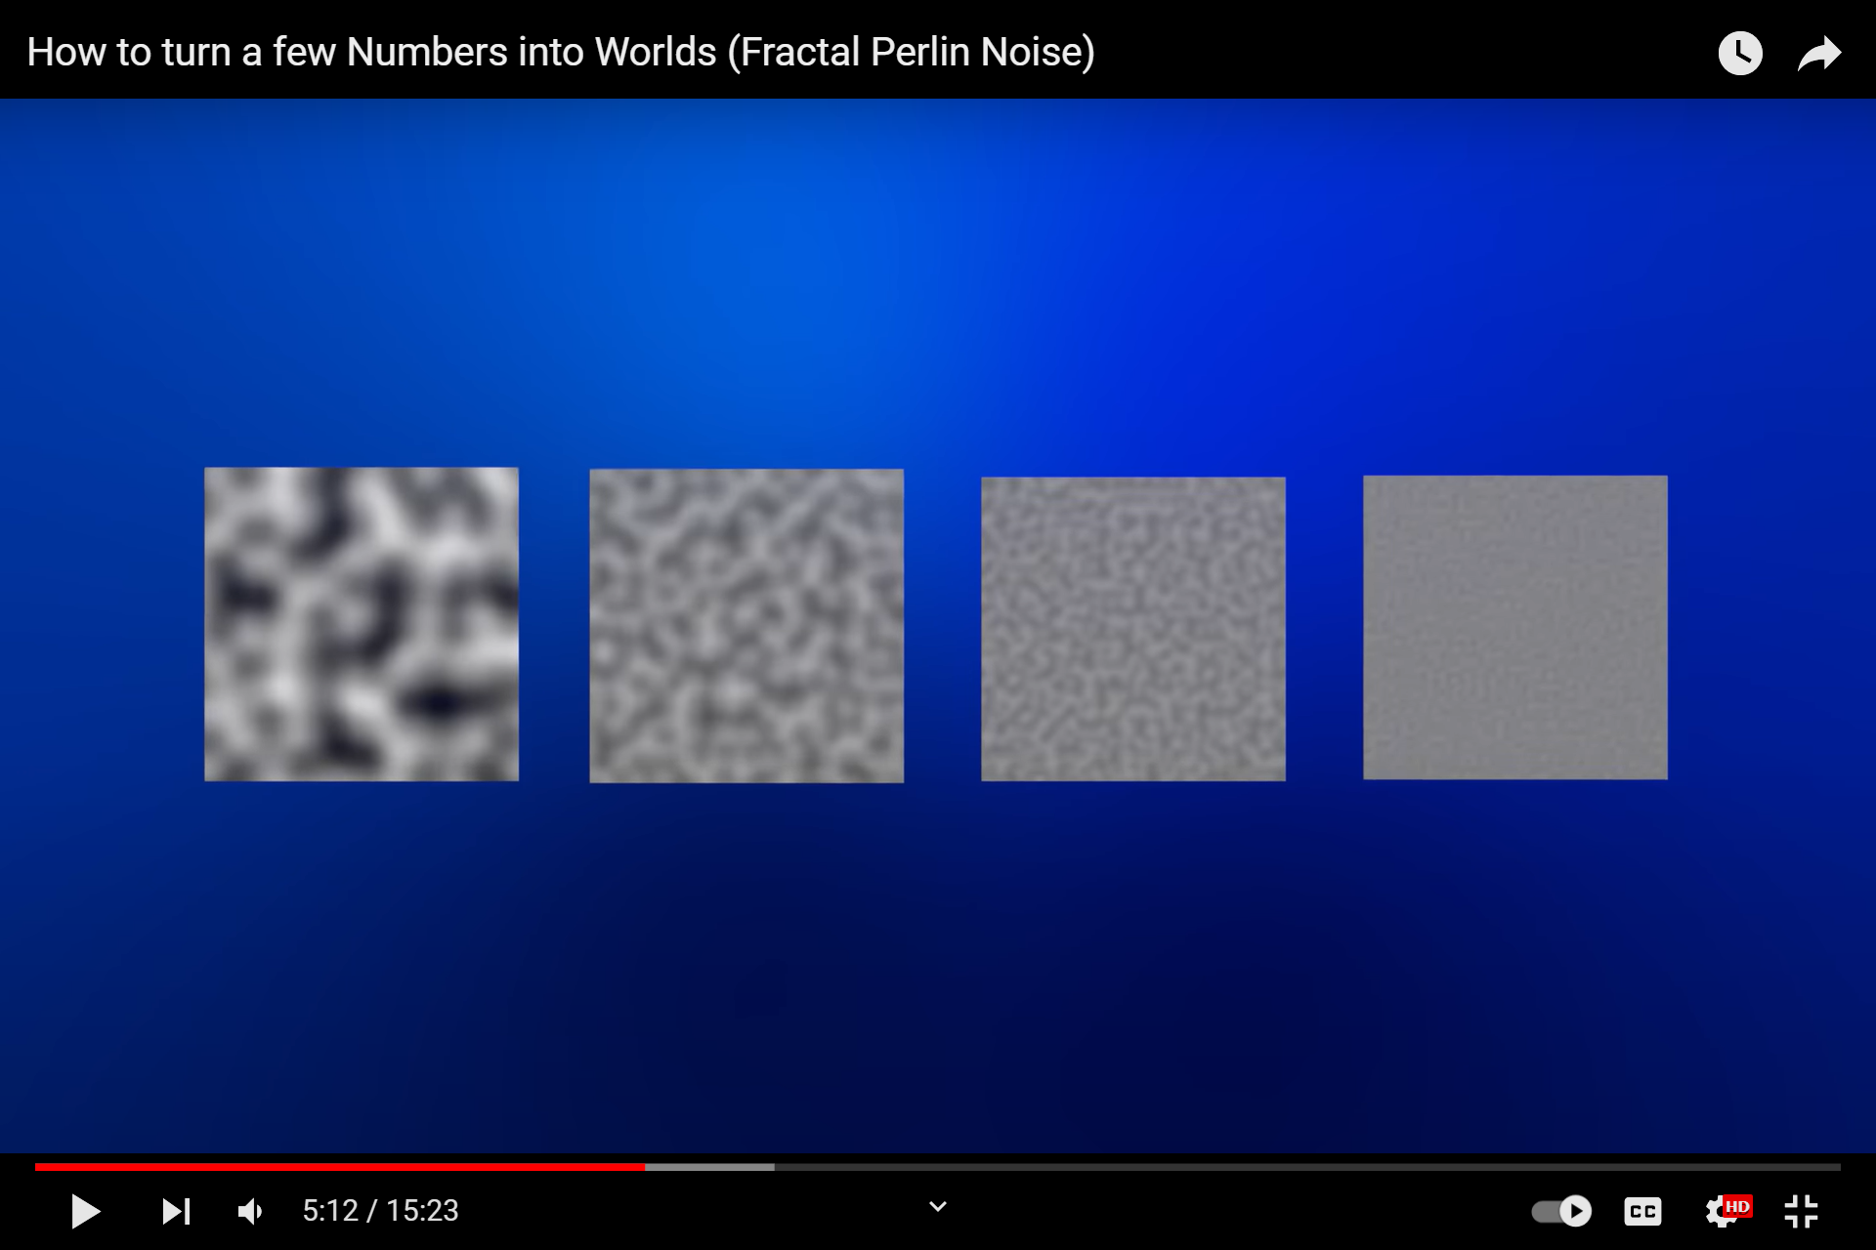
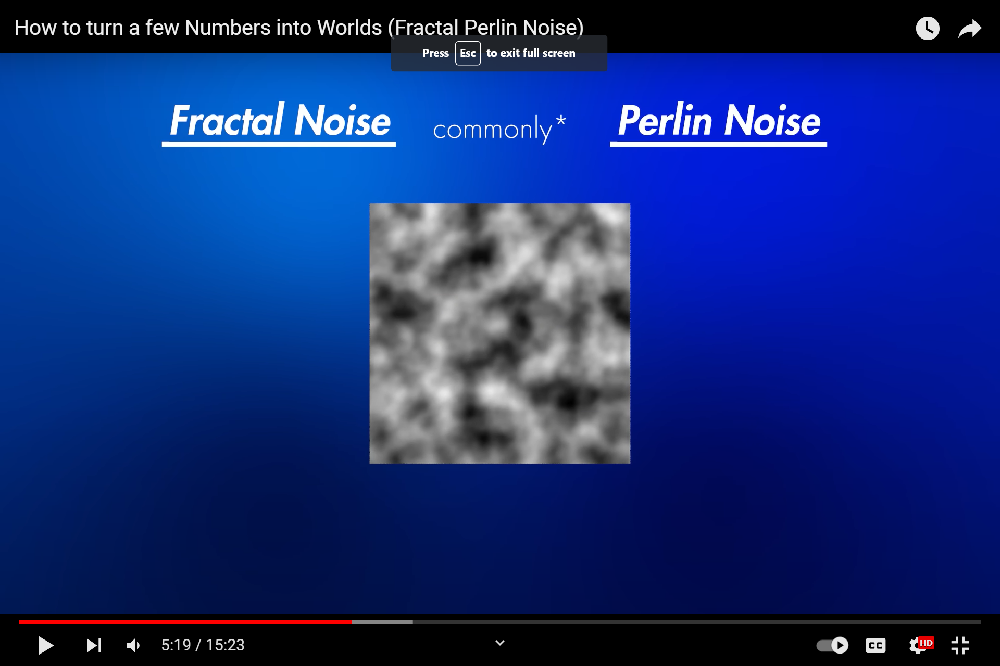
Perlin Noise – Theory 3/3
Ewan Walker
References:
Octaves - https://www.youtube.com/watch?v=ZsEnnB2wrbI
+
+
+
=
O1
O2
O3
O4
Perlin Noise
1
2
4
8
6. The heightmap C is now represented by O1 – the first octave. It is blurry; therefore, this process is repeated but doubling the density of cells, known as increasing the octave (nth octave for n=1,2,3,4).
7. The octaves are simply added together, with decreasing weight (i.e. by a persistence factor of 0.5 for each extra octave) and then scaled as appropriate to the application.

Slide 21
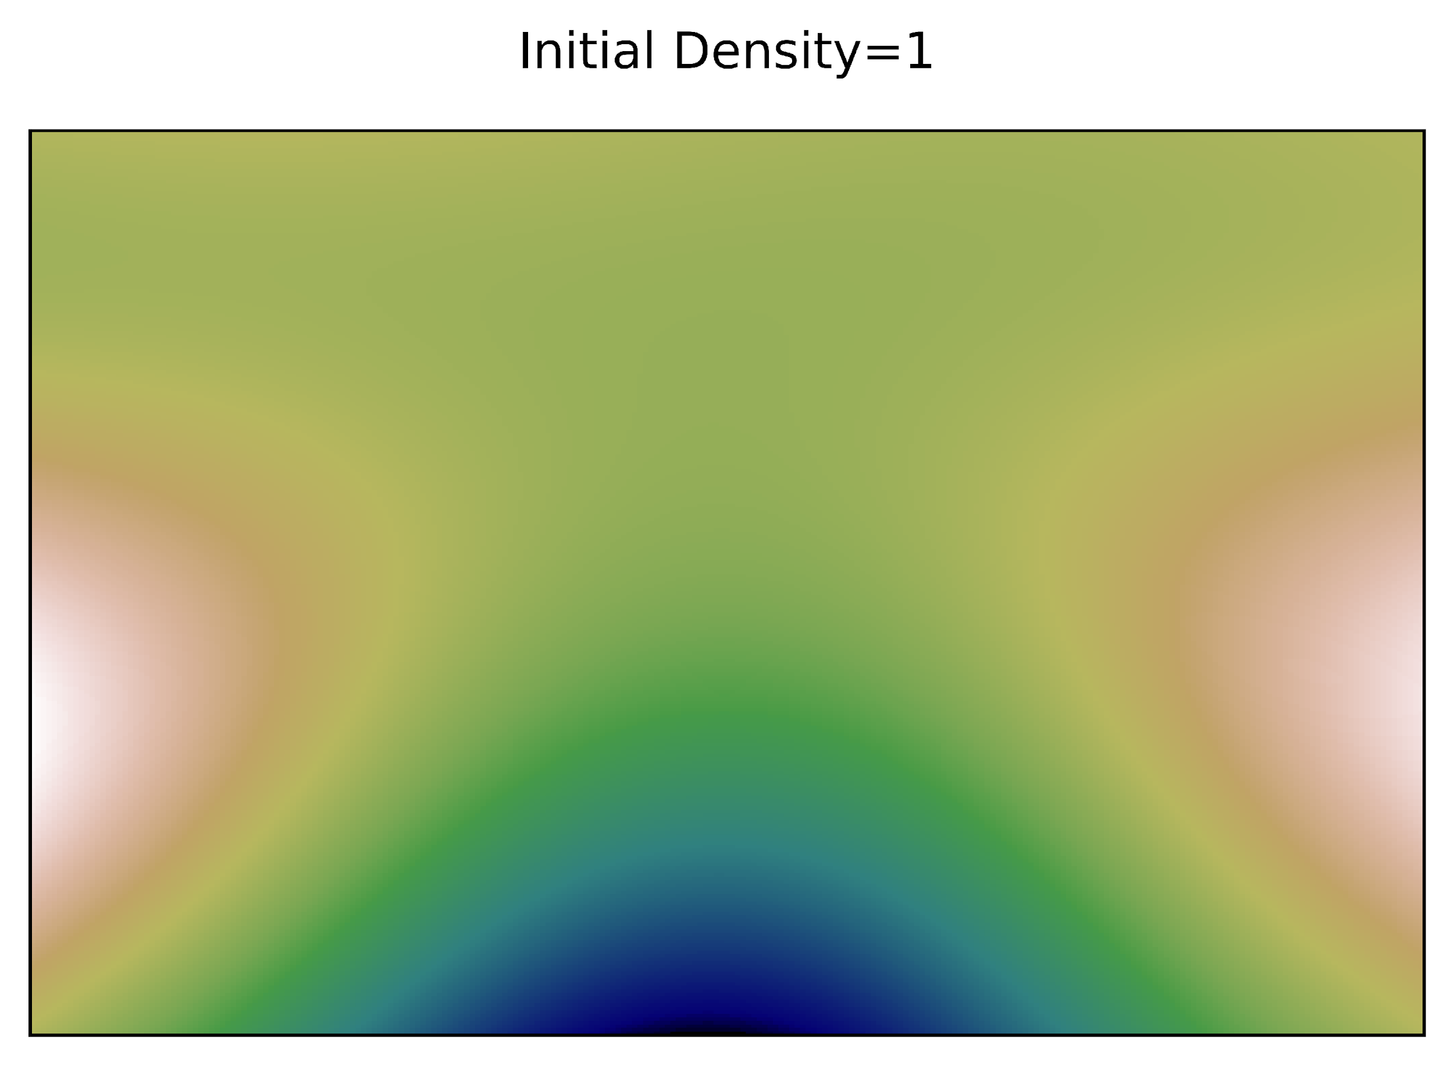
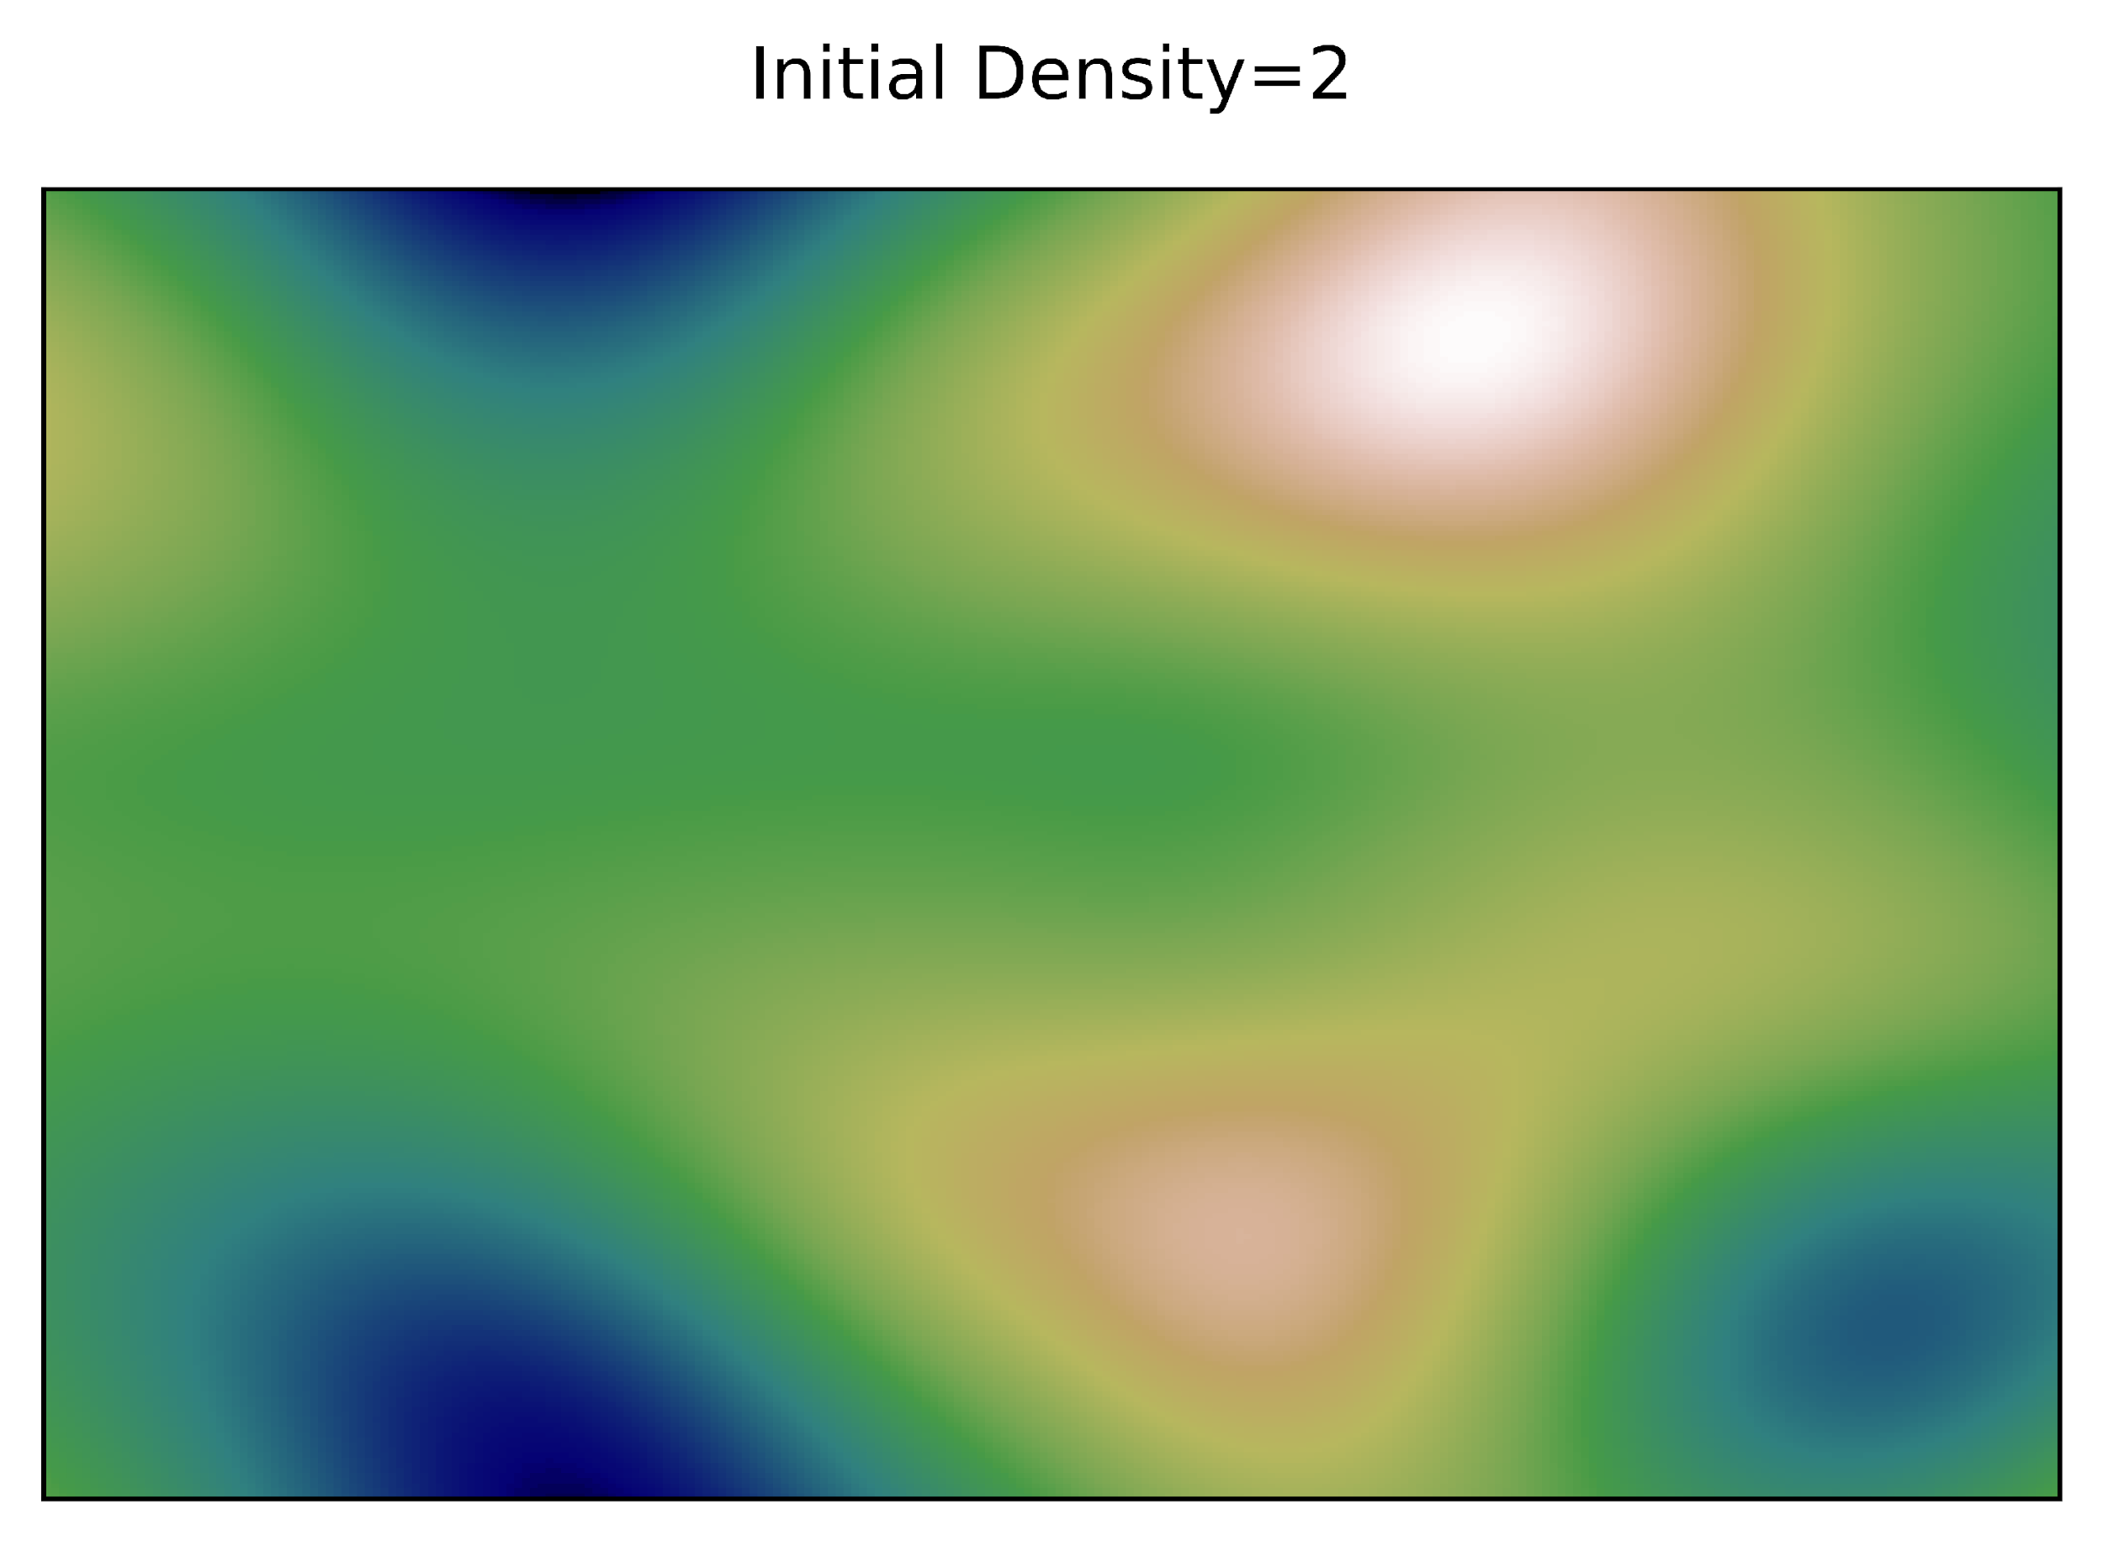
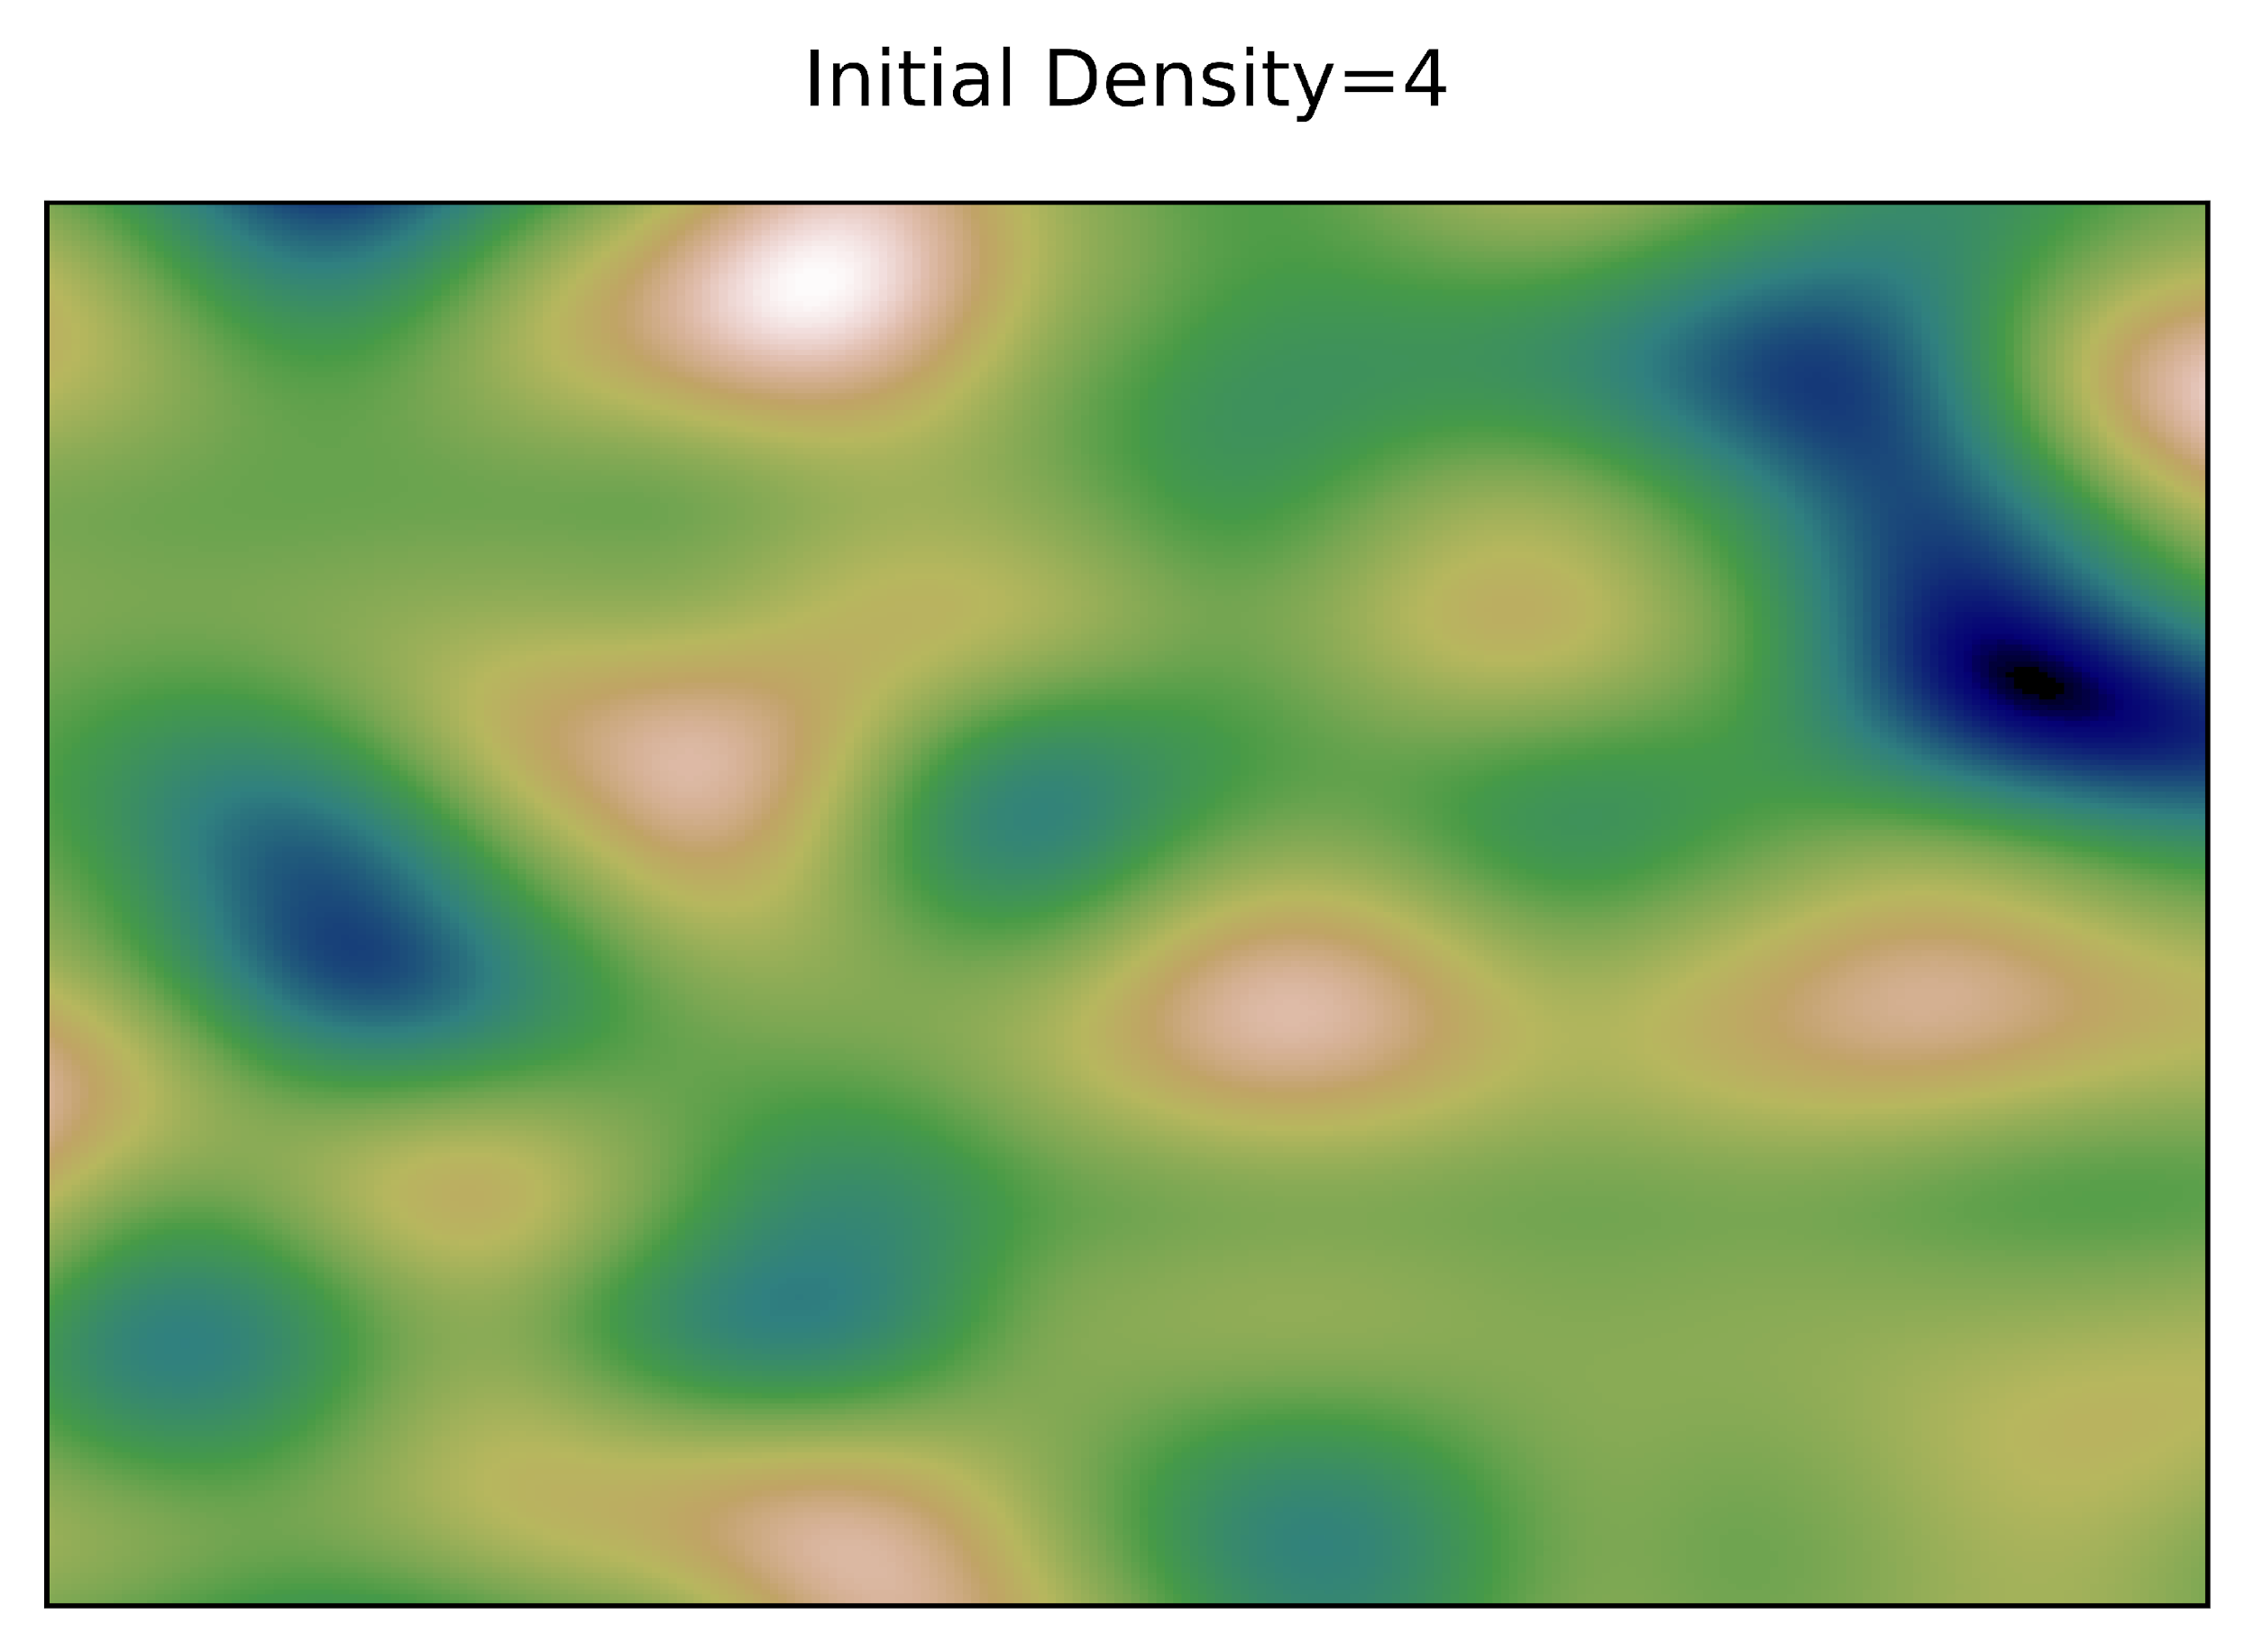
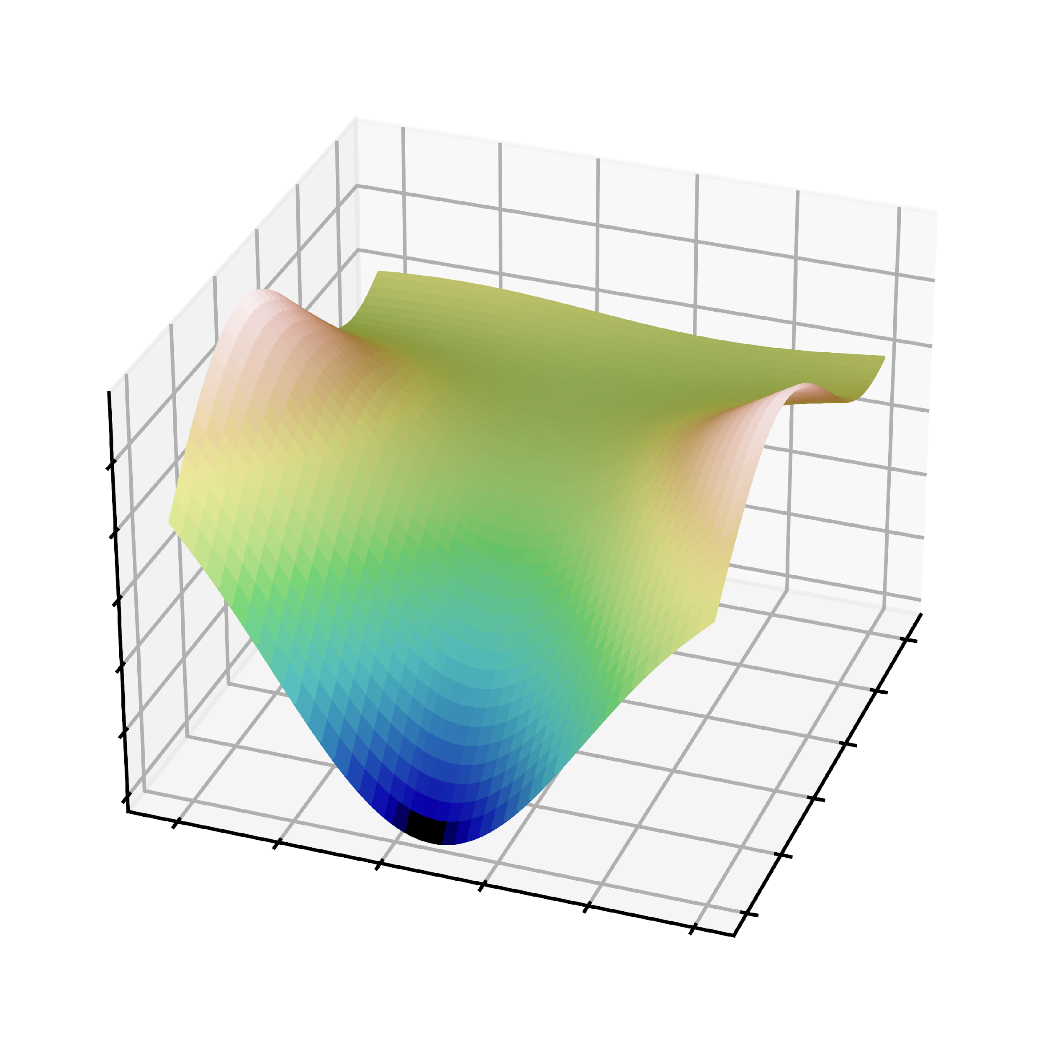


Perlin Noise – Result Analysis
Ewan Walker
References:
Package - https://pypi.org/project/perlin-noise/
1
0
-1

Slide 22




Diamond Square vs Perlin Noise
Ewan Walker
1
0
-1

Slide 23



Principle Component Analysis (PCA) Harry Fletcher
Purpose:
This is used to greatly reduce the volume of data within the dataset whilst preserving an optimal amount of information
Procedure:
Standardise the range
Compute the covariance matrix, then remove data points with high similarity to preserve information and remove data
(Equations and matrix produced in latex)

Slide 24

3. Find eigenvalues and eigenvectors to determine Principal values, which are a linear combination and uncorrelated.
4. Order eigenvalues and eigenvectors in descending order, then determine least significant principal values and remove them, forming A vector matrix with the remaining eigenvectors namely the feature vector
5. Using the feature vector, try to reorient the data so it's like that represented by the principal components

Slide 25


PCA example code
Reduces the data into 2 principal values and shows that the 1st explains < 99% of the data and the 2nd explaining > 1%
We are planning on using this idea to reduce the data from a lidar scan of Newcastle from the gov website to a few points as shown here.

Slide 26

Auto-Encoding
Process:
Inputs data.
First encoding layer.
New encoding layer (reduced number of neurons).
Final encoding layer (captures the most important information).
First decoding layer.
New decoding layer with increased number of neurons.
Output (same number of neurons as the input data)

Slide 27

Auto-Encoding
Loss Function:
A function that minimizes the error between input and output data.
Calculated while the autoencoder is being trained.
If there are a number of samples n:
Example: Squared Error Loss Function
x = input W = weight vector of the encoder
b = bias of encoder
x' = output
W′ = weight vector of the decoder
b' = bias of the decoder
References: https://www.researchgate.net/profile/Sanjay-Sahay-2/publication/339480272_An_Overview_of_Deep_Learning_Architecture_of_Deep_Neural_Networks_and_Autoencoders/links/5e7a1731299bf1e649f7279c/An-Overview-of-Deep-Learning-Architecture-of-Deep-Neural-Networks-and-Autoencoders.pdf

Slide 28



